Slide 1
Human-to-human transmission of Andes virus (ANDV) modeled in the Syrian Hamster
Silke Riesle-Sbarbaro
Centre for biological threats and Special Pathogens
Riesle-Sbarbaro et al. (2023) Emerging Infectious Diseases

Slide 2
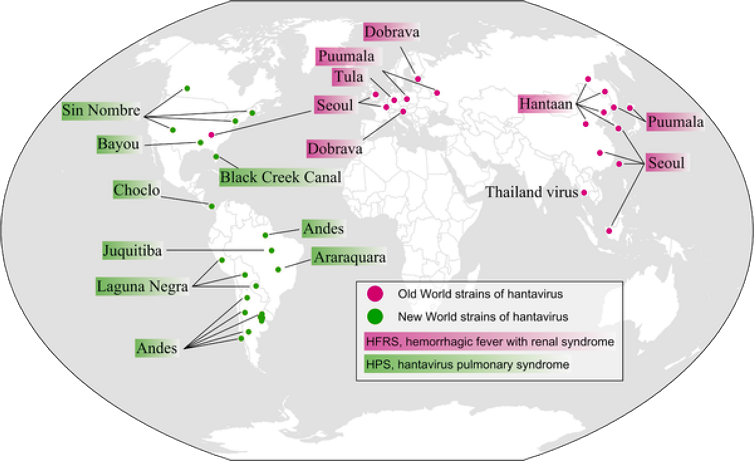
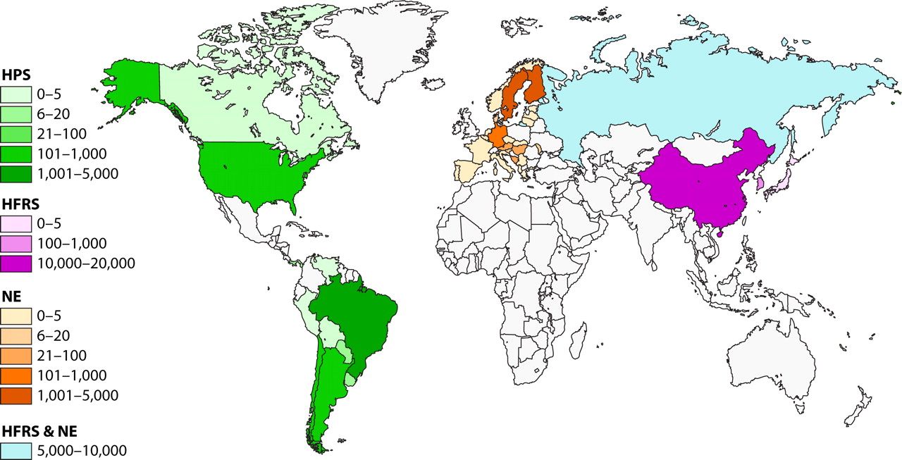
Hantaviruses Distribution
Disease Epidemiology
Aguilar PV, PLOS NTD 2019
Jonsson C, Clin Mic Rev 2010

Slide 3
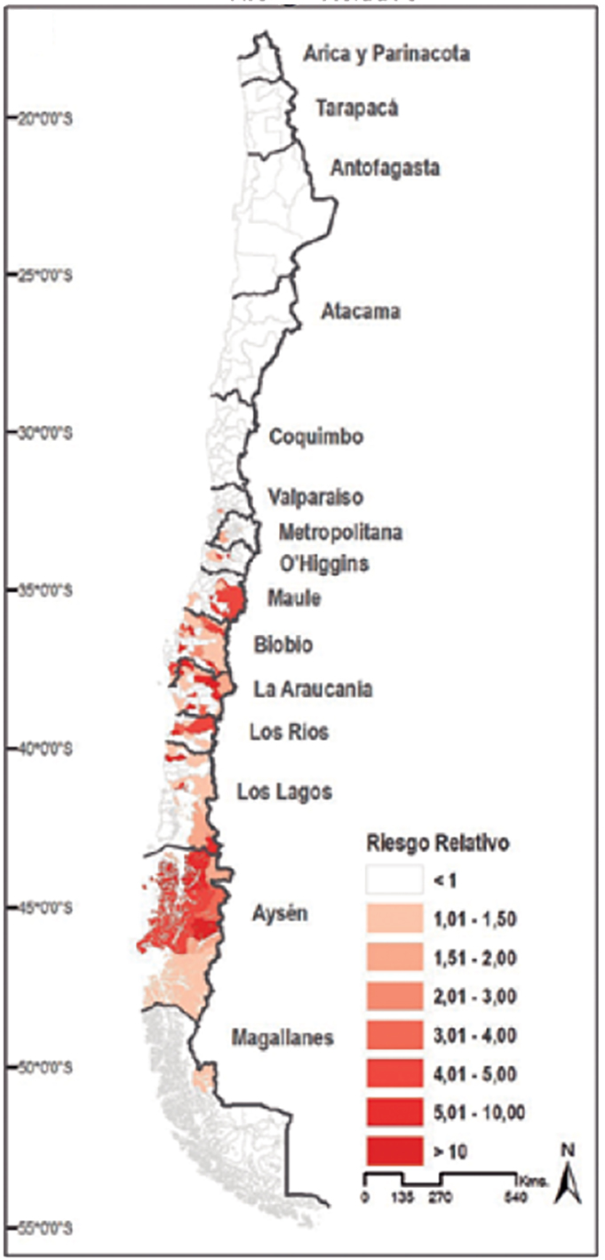
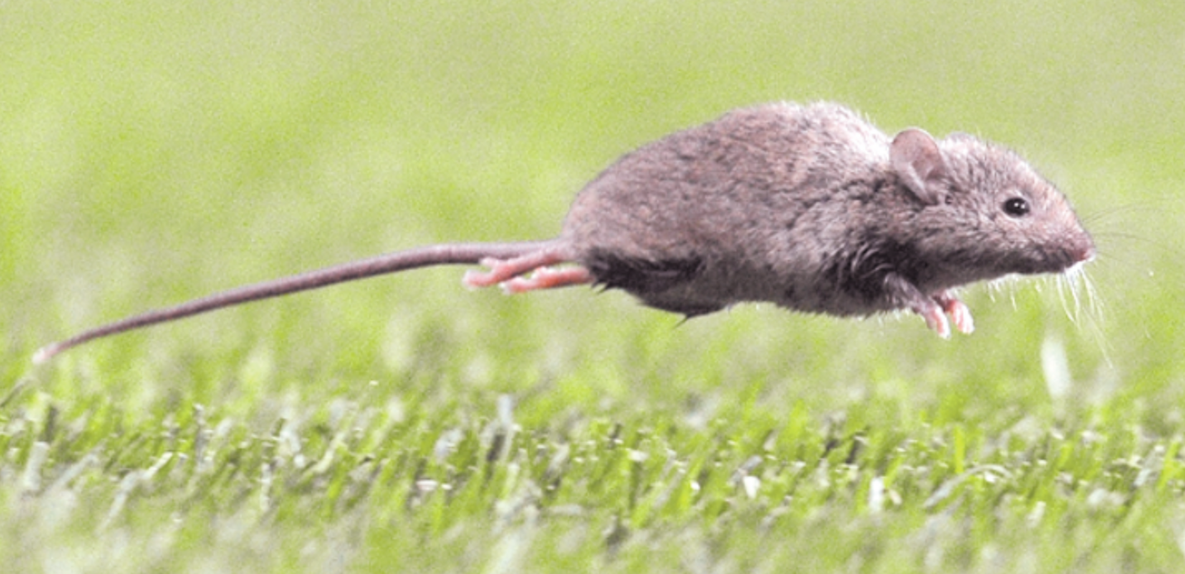

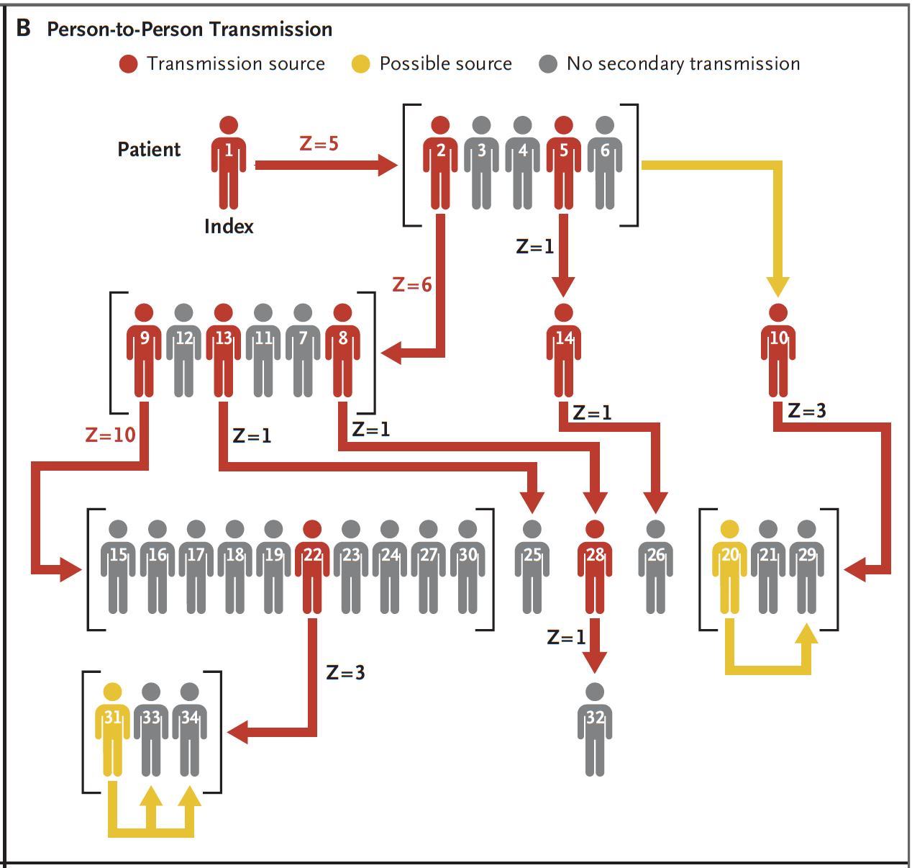

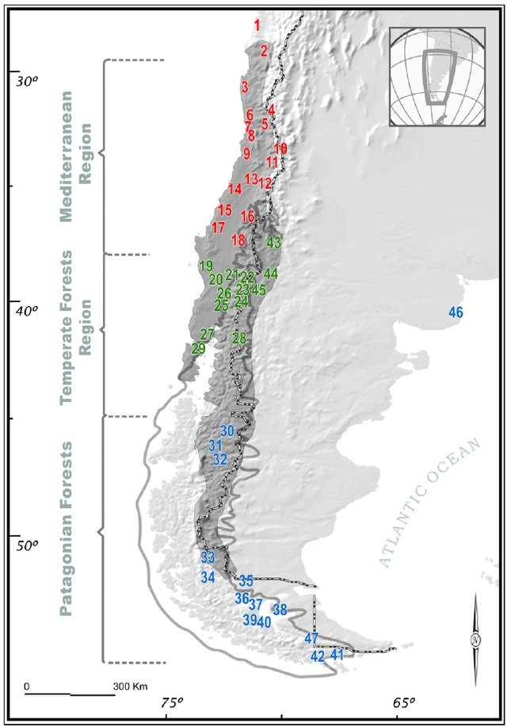
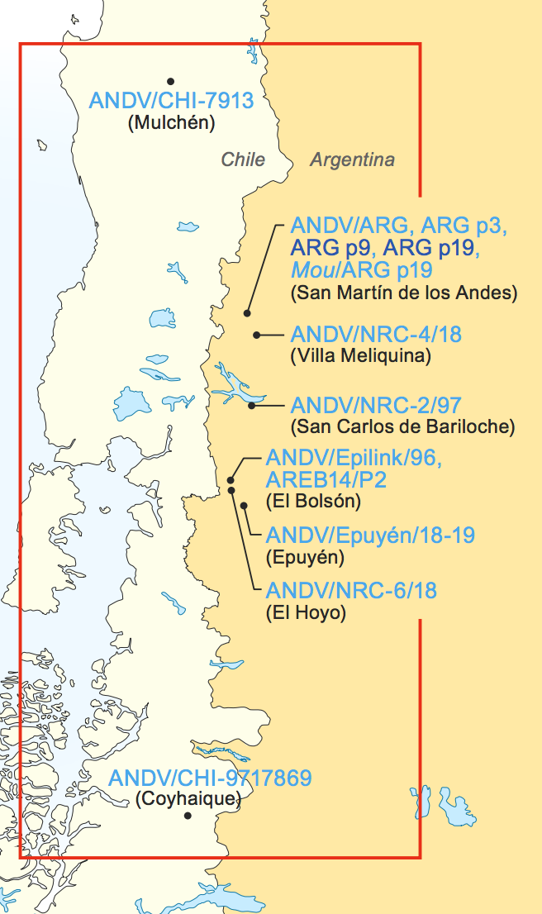
Zoonotic transmission – Andes virus
Reyes, Rev Chi Inf 2019
Palma, PLOS ONE 2012
Bellomo, mSphere 2023
Martinez, NEJM 2020

Slide 4
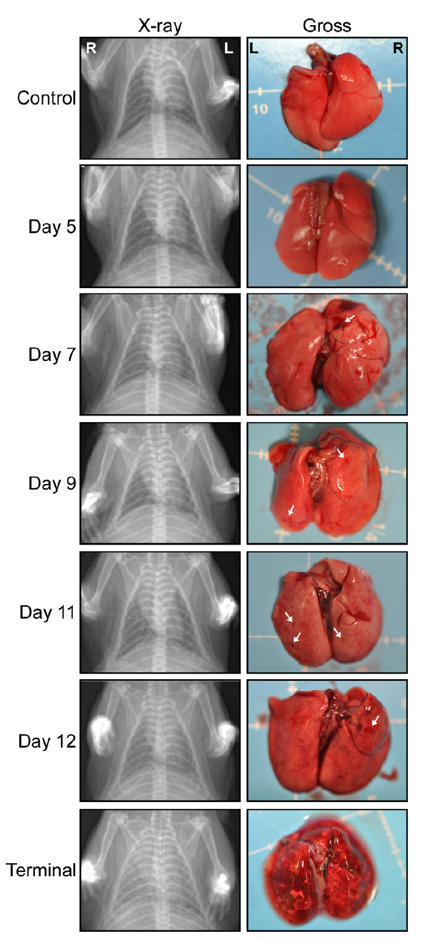
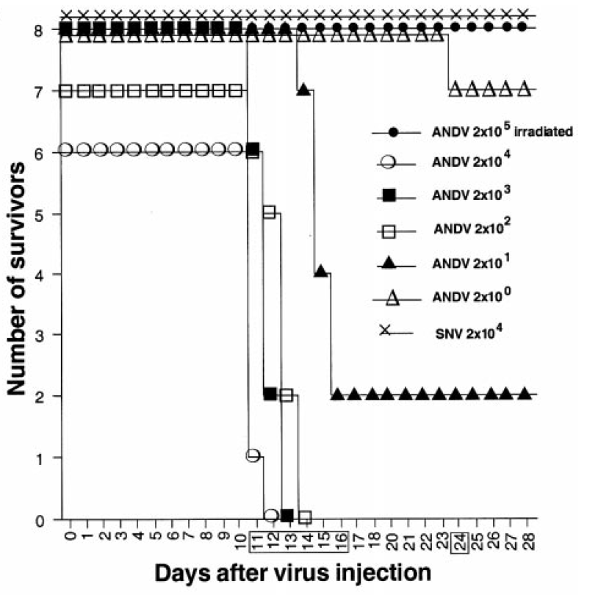
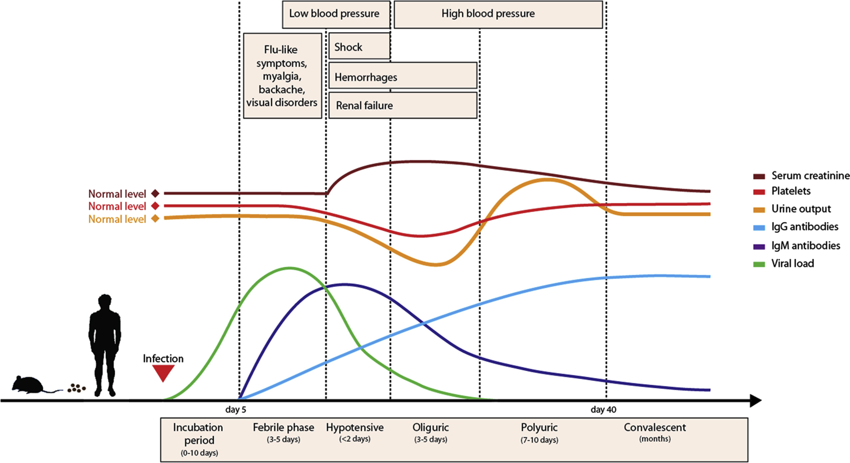
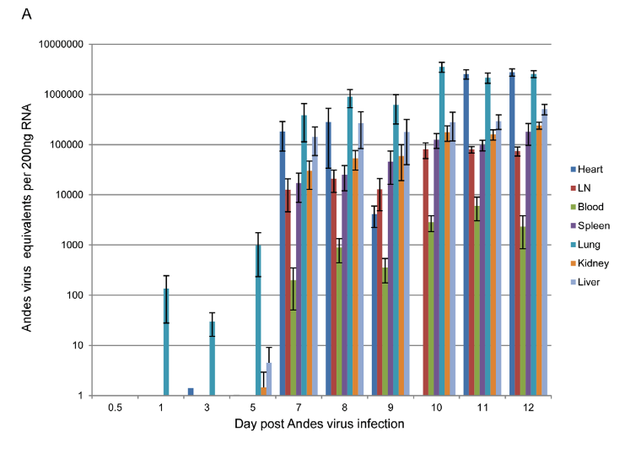

Hantavirus-induced cardiopulmonary syndrome – animal model
Hooper, Virology 2001
Avšič-Županc, Clin Microb 2019
Incubation
(7 – 19 days)
Acute phase
(12 – 24 h)
Safronetz, PLOS Path 2011

Slide 5
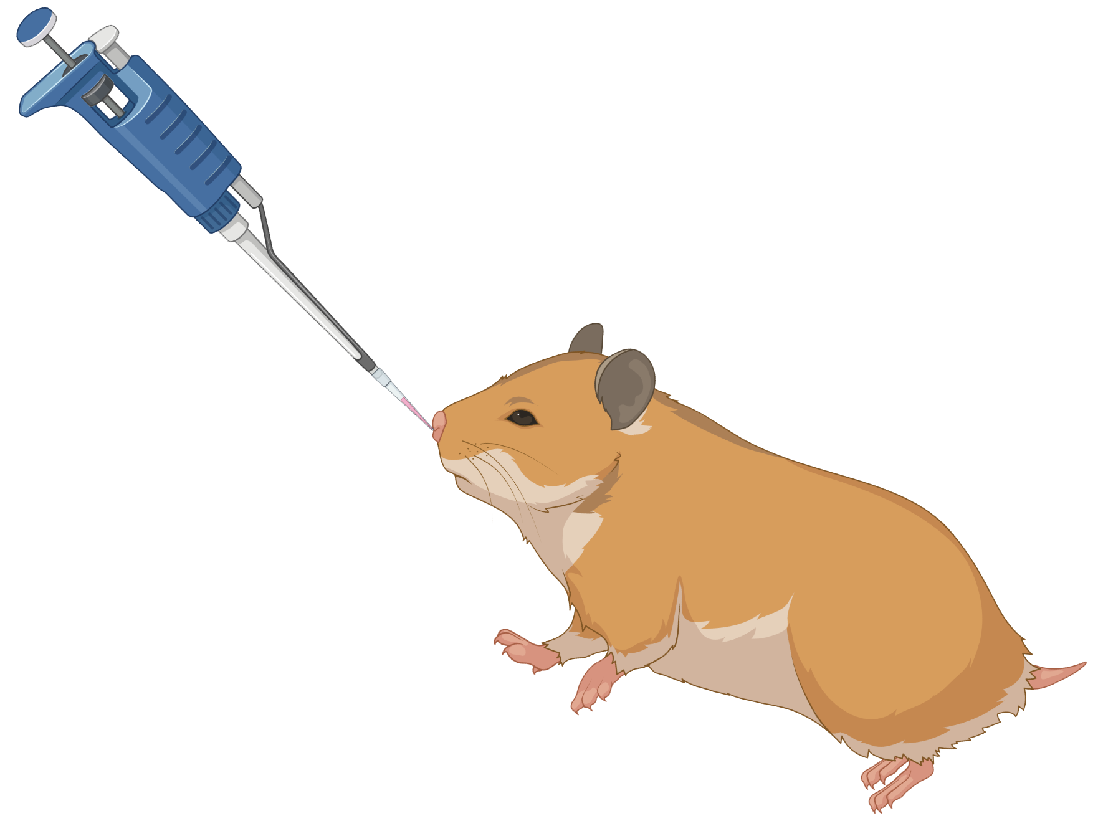
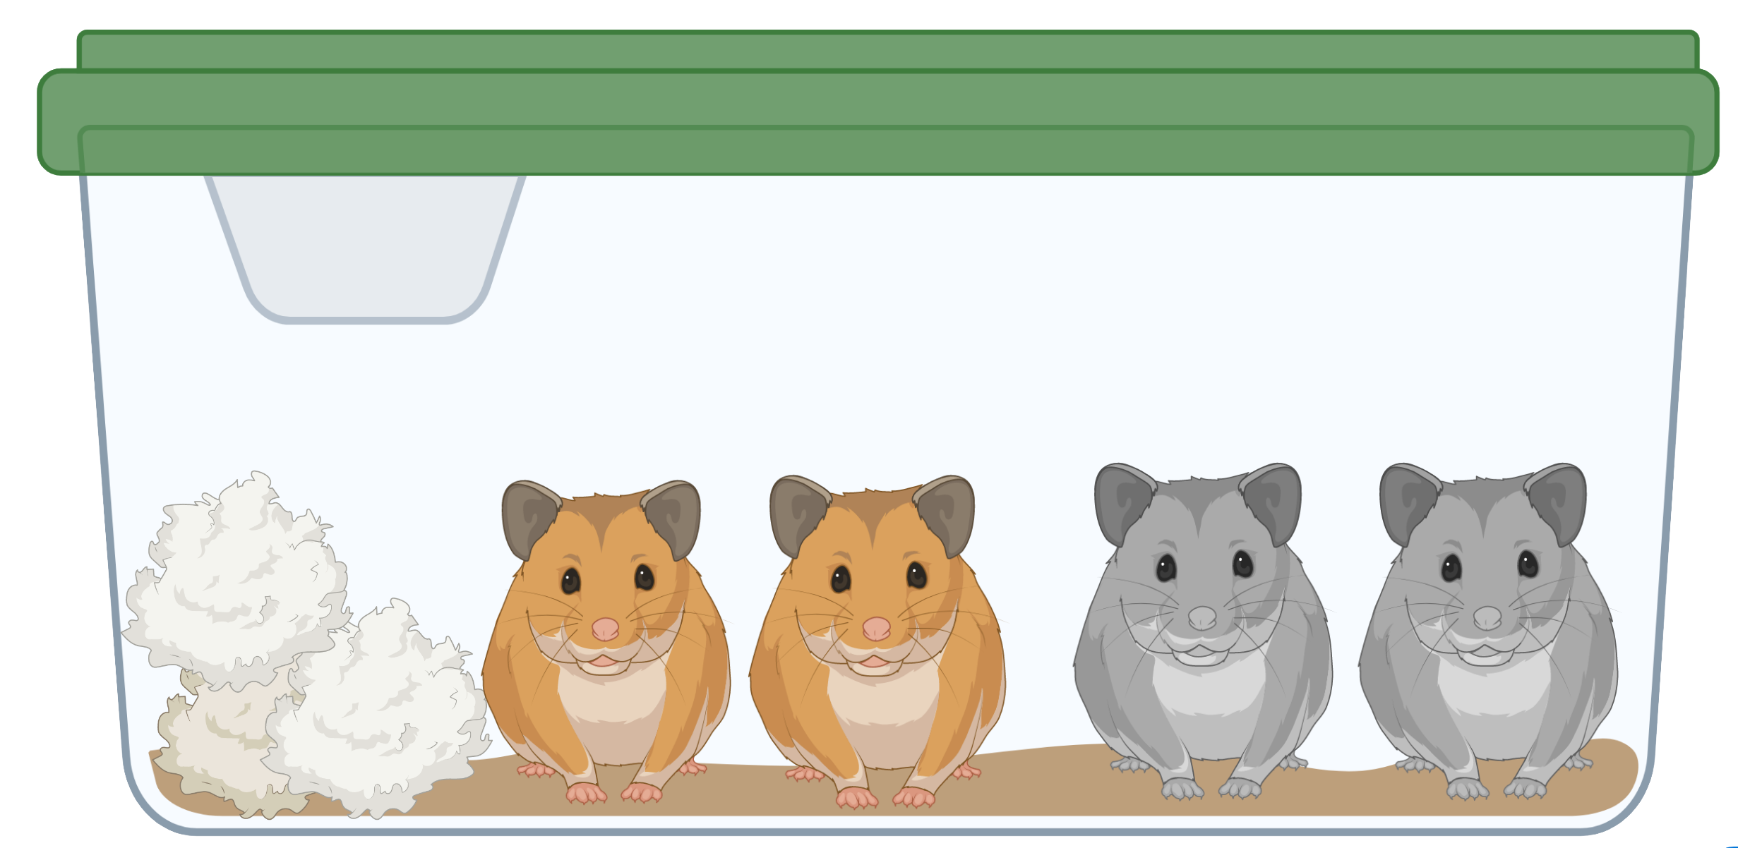
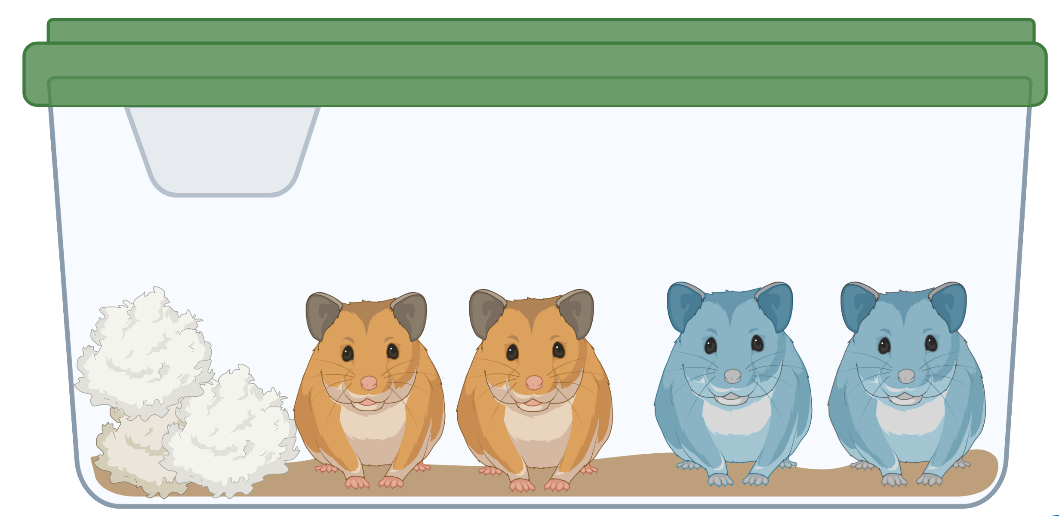


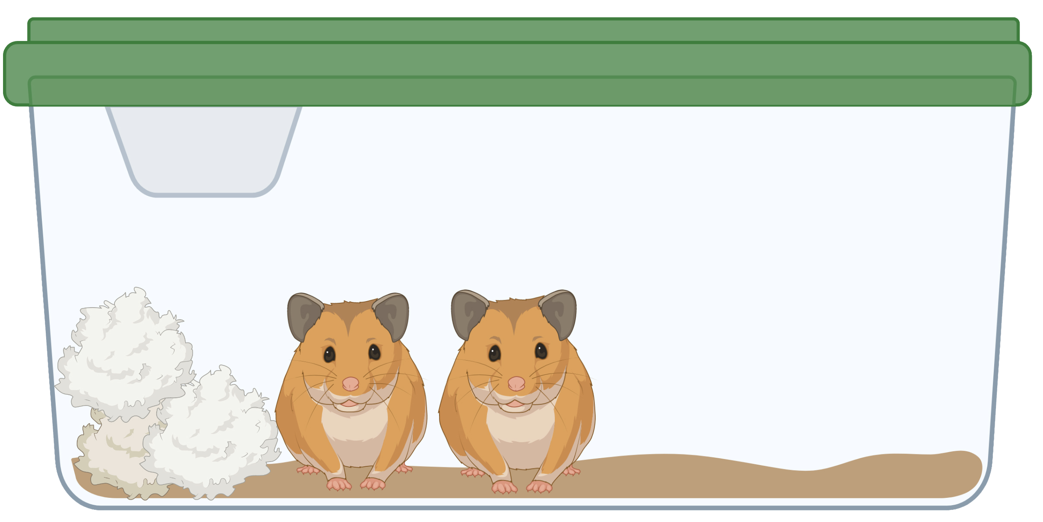
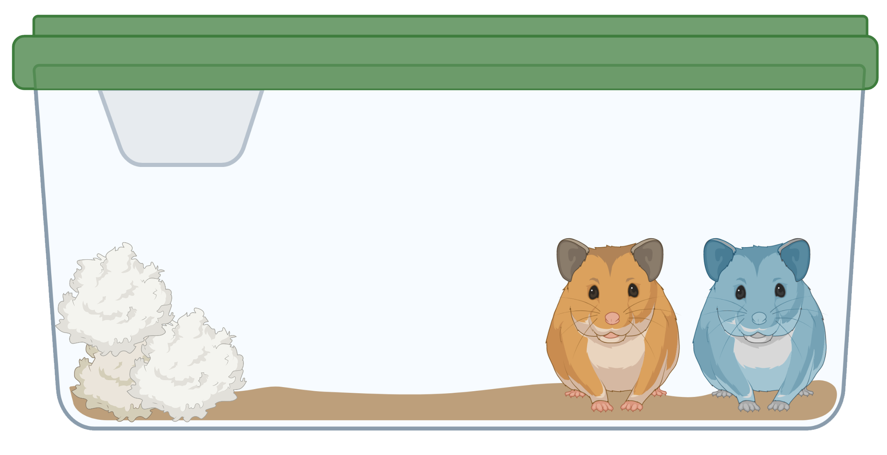
Experimental design of the pilot study
ANDV CHI-9717869
200 PFU/eq
N= 12
N= 12
-10 dpi
0 dpi
1 dpi
~12 dpi
40 dpi
Acclimatization
Inoculated
Naïve

Slide 6
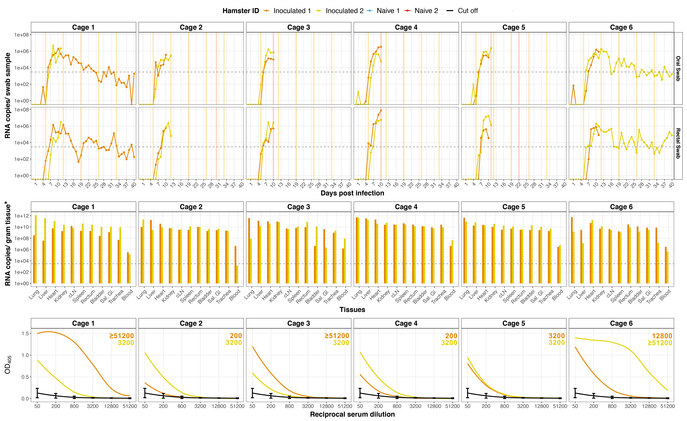
Infection, shedding and transmission
Average shedding onset = dpi 5 (o) - 6 (r)
Peak RNA = 1 day pre-euthanasia

Slide 7
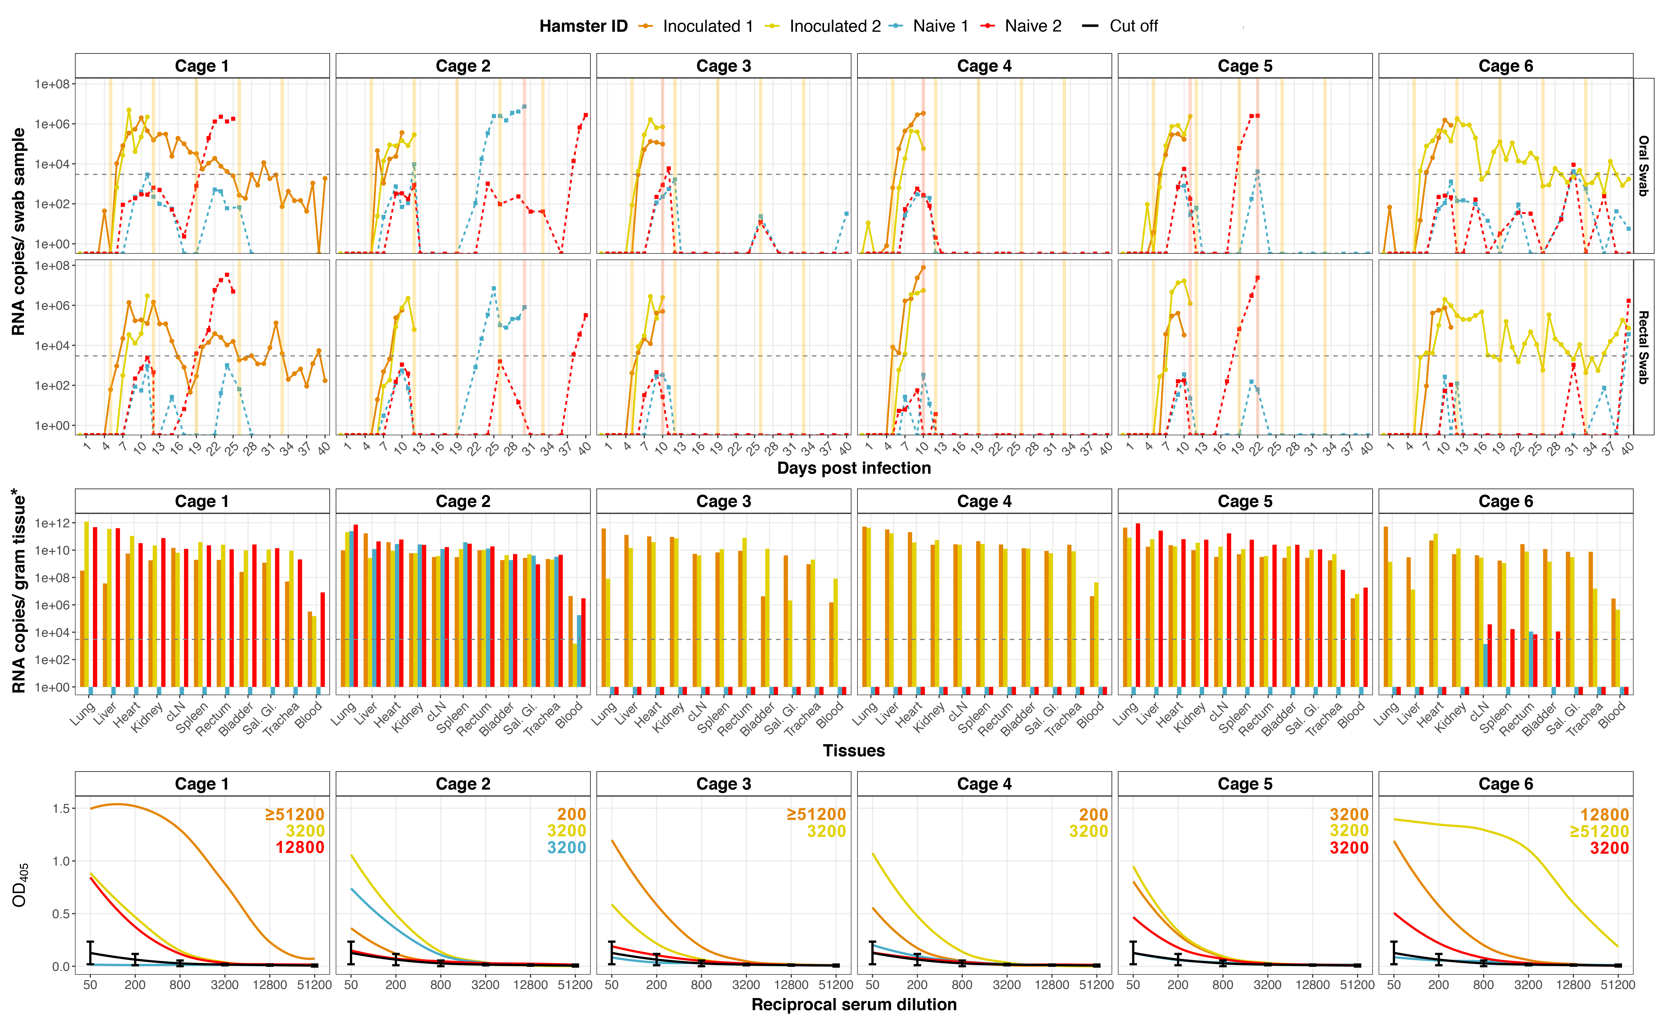
Infection, shedding and transmission
Average shedding onset = ---
Peak RNA = Day of euthanasia

Slide 8
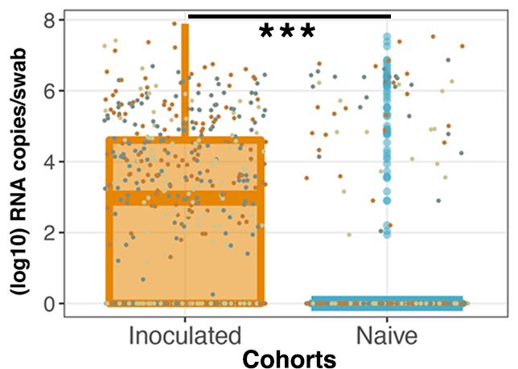
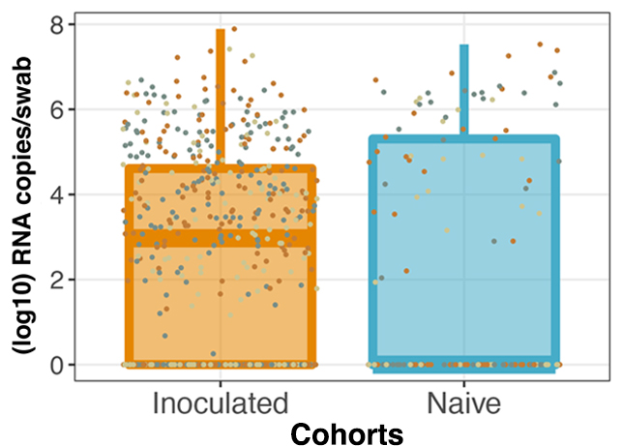
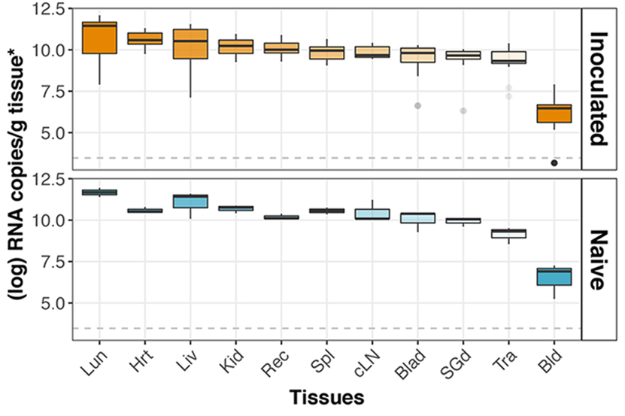
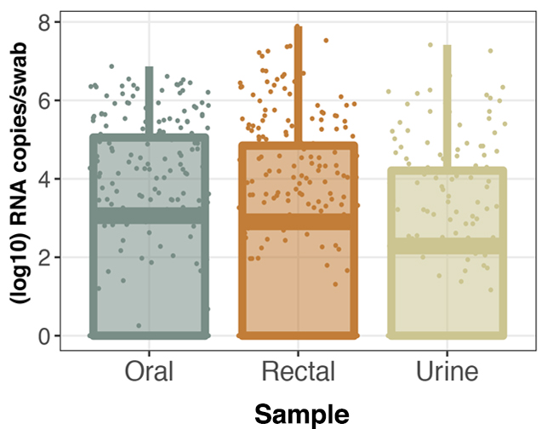
Adjusted incubation days (AID)
Shedding between cohorts - infected animals
* NS without/with survivors

Slide 9
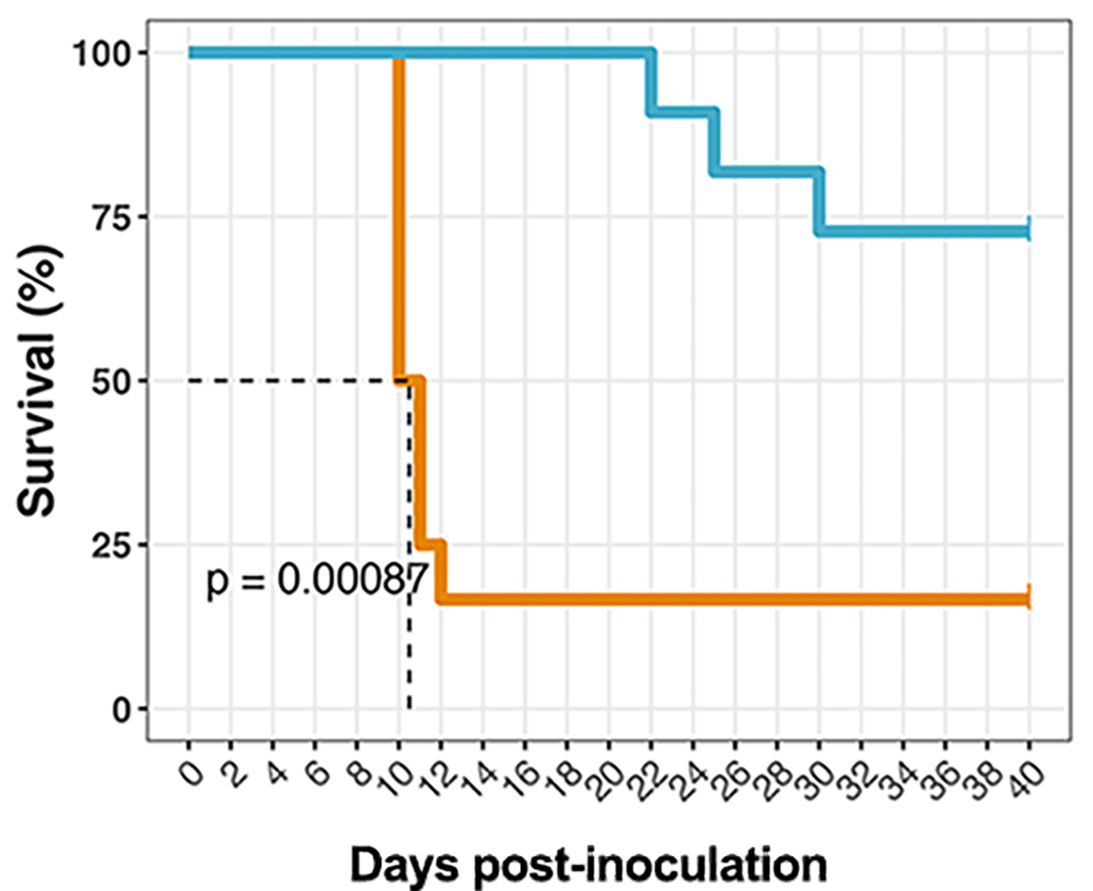
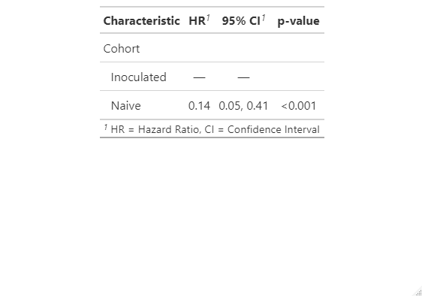
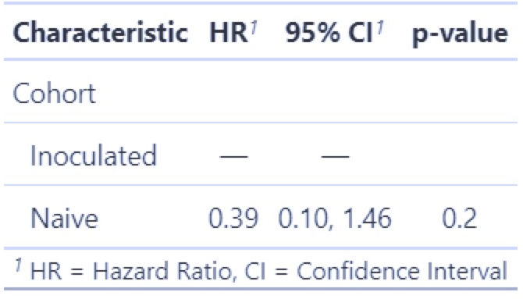
Clinical parameters – cohorts (AID)
Survival
% weight change
% temperature change

Slide 10
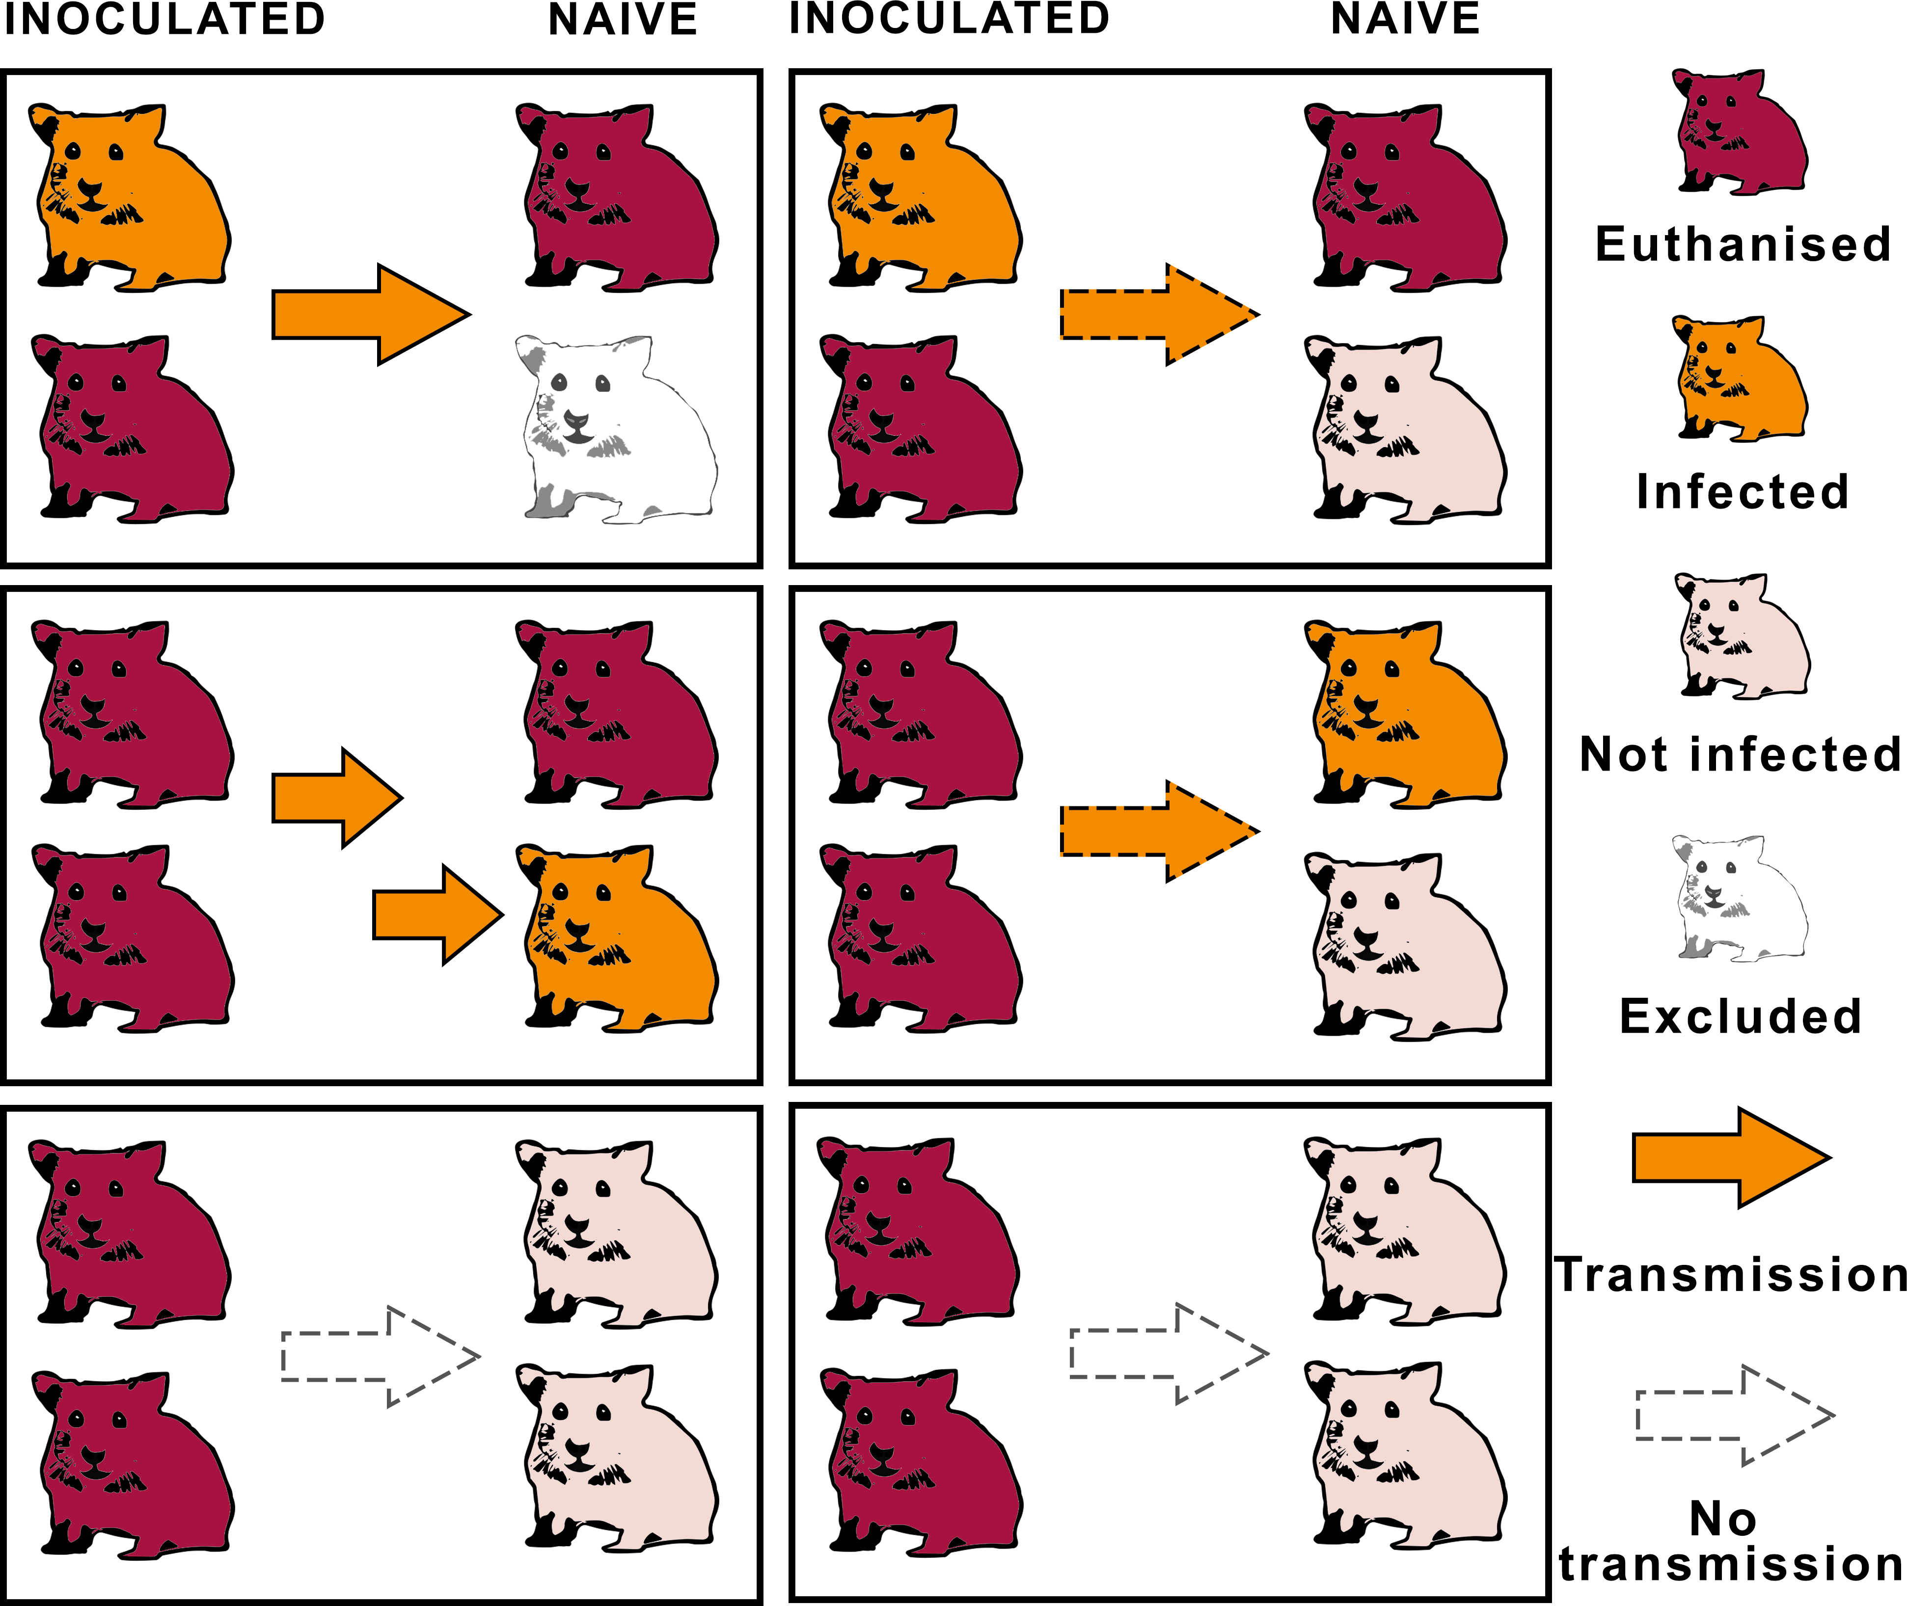


Summary
Model of horizontal ANDV transmission & method for monitoring infection.
Asymptomatic & persistent shedders.
Persistent shedding is infectious, not only virus RNA.
Infection (i.n. or other) leads to consistent shedding through all routes – Model simplification.
Forward
Accurate incubation time & transmission rates
Routes of horizontal transmission?
Virus selected for horizontal transmission?

Slide 11
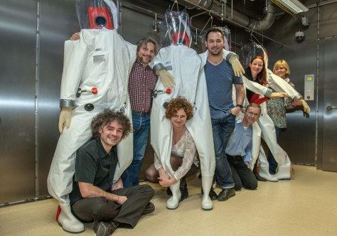
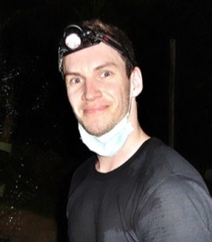


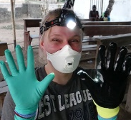

Acknowledgements
Centre for Biological Threats and Special Pathogens
Biosafety Level 4 Laboratory
Andreas Kurth
Joe Prescott
Norman Kirchoff
Katharina Hansen-Kant
Angelika Lander
Alice Stern
Colorado State University
Tony Schountz
10.10.23
11

