Slide 1
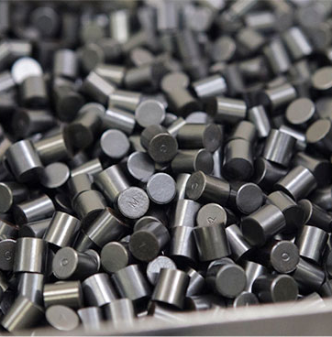



Simulation of grain morphology evolution during sintering
Evan Pereira (2nd year Ph.D)
Jacques Léchelle, Adrien Socié, Luca Messina – CEA Cadarache IRESNE
François Valdivieso, Julien Bruchon – Ecole des Mines Saint-Etienne
Gaelle Raveu, Maelys Gauthé – Framatome

Slide 2
Introduction
1

Slide 3
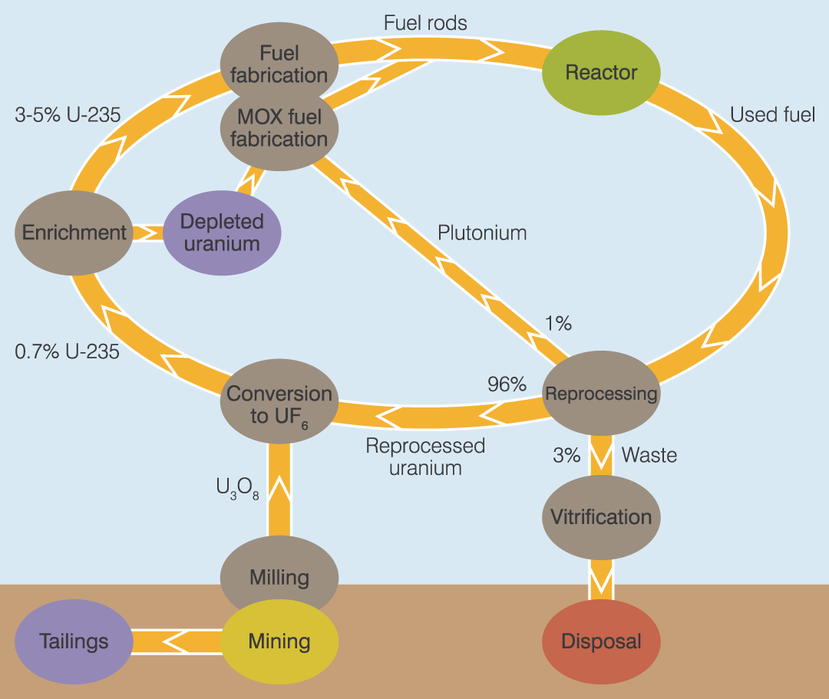
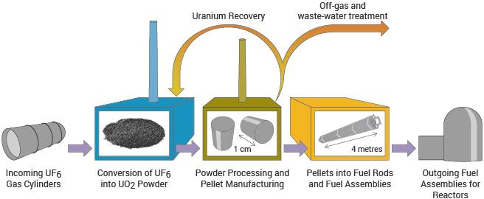
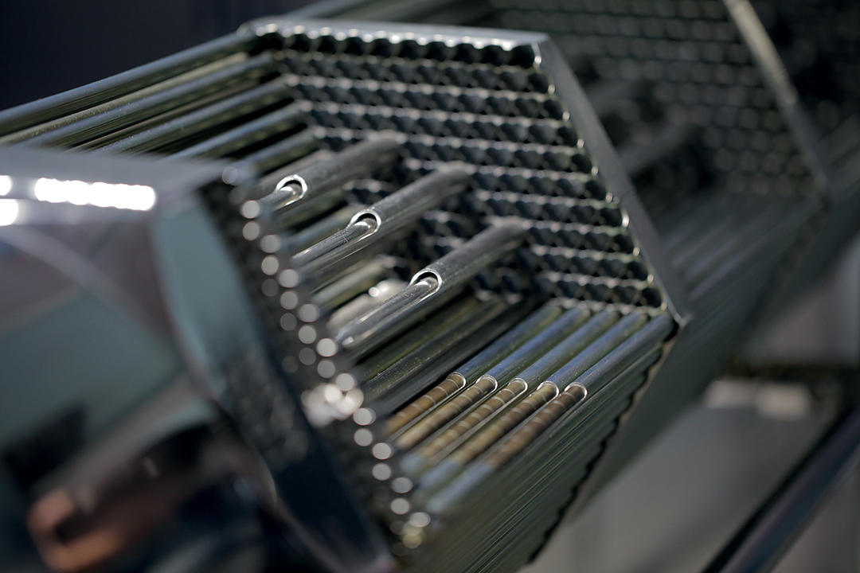
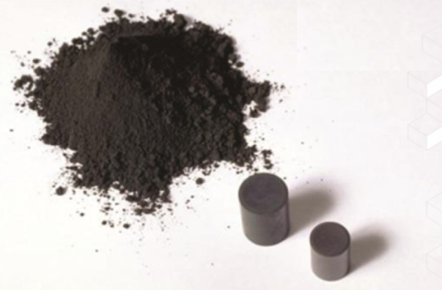
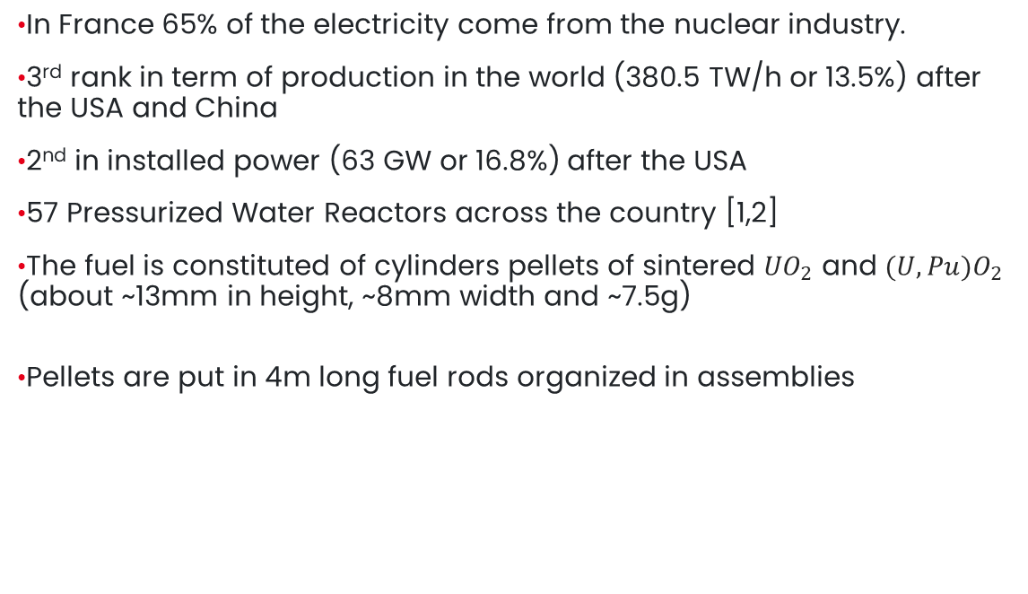
Context : Nuclear Fuel
In France 65% of the electricity come from the nuclear industry.
3rd rank in term of production in the world (380.5 TW/h or 13.5%) after the USA and China
2nd in installed power (63 GW or 16.8%) after the USA
57 Pressurized Water Reactors across the country [1,2]
The fuel is constituted of cylinders pellets of sintered ${UO}_{2}$ and ${(U,Pu)O}_{2}$ (about ~13mm in height, ~8mm width and ~7.5g)
Pellets are put in 4m long fuel rods organized in assemblies
[4]
[3]
[1] 2025 Statistical Review of World Energy, Energy Institute
[2] 2025 World Statistic International Atomic Energy Agency
[3] Framatome Romans R&D presentation
[4] World nuclear association https://world-nuclear.org/information-library
[4]
Notes:
ENVIRON

Slide 4
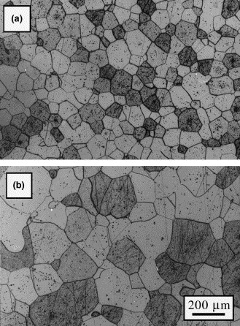
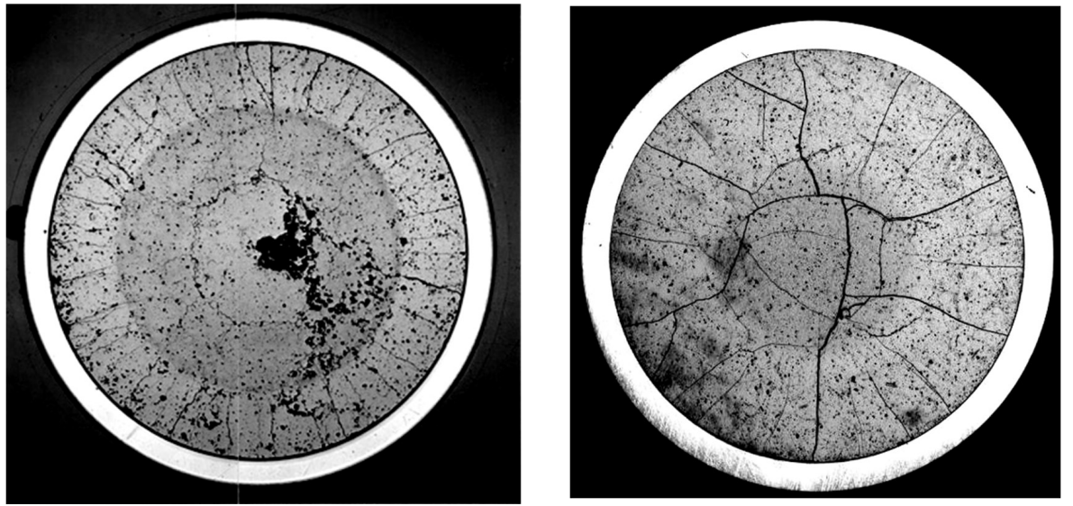
Accident Tolerant Fuels
Potentiellement slide bonus
Current developments in nuclear fuels are aimed at Accident Tolerant Fuel technologies, to enhance safety and performance.
One of them is Chromia-doped fuel pellets, to retain fission gases better and improve pellet-cladding interaction.
UO₂+0.1 wt% Cr₂O₃
UO₂+0.25 wt% Cr₂O₃
Pure UO₂
Cr₂O₃ doped UO₂
Bigger grains, which improves fission gas retention [1]
More radial cracks in the periphery of doped UO₂ → relieve of stress [2]
[1] L. Bourgeois and al., Factors governing microstructure development of Cr₂O₃-doped UO₂ during sintering, Journal of Nuclear Materials, 2001
[2] Nonon et al., PCI Behaviour of Chromium Oxide-Doped Fuel, OECD, Nuclear. Energy Agency, 2005
Notes:
Ph. D. topic : sintering model accounting for different interspecies diffusion (U, Cr) and initial morphology

Slide 5
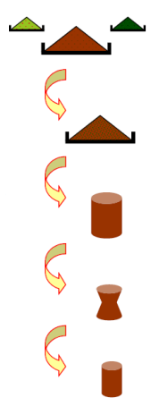
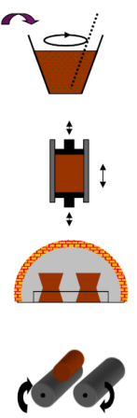
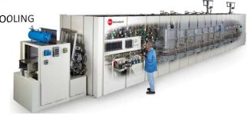
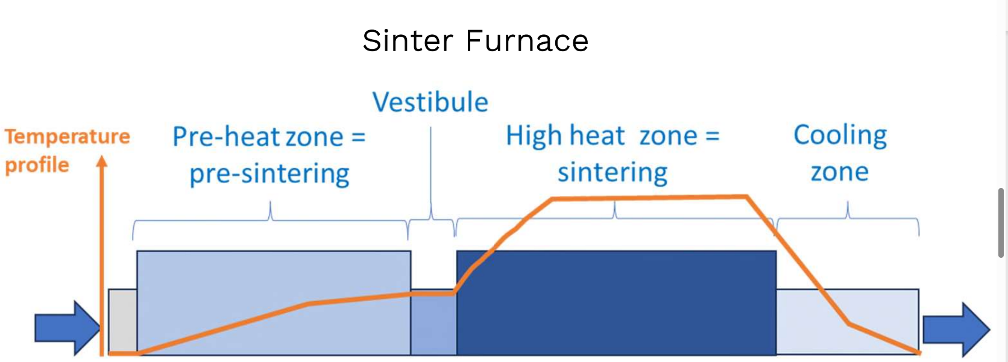
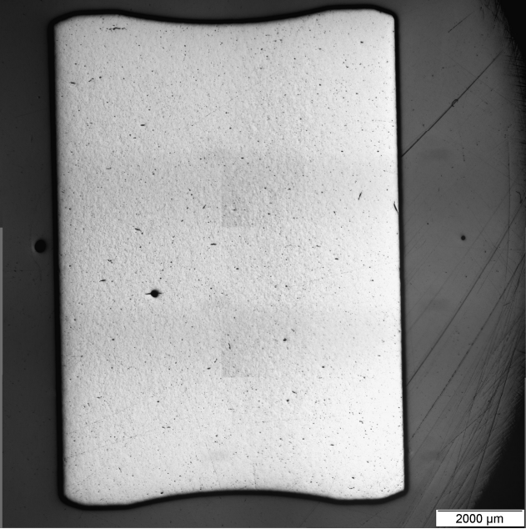
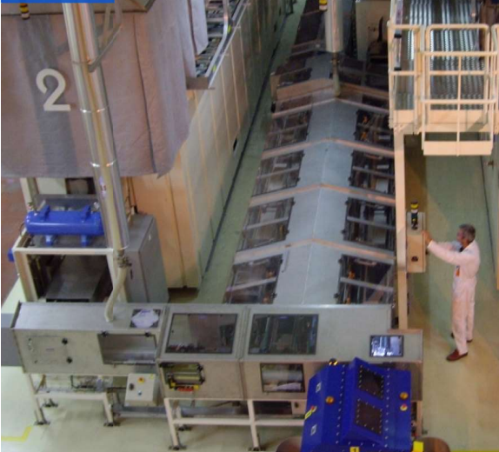


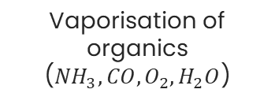
Context : Manufacturing of fuel pellets
raw material
Pellet manufacturing is one of the last steps of the fuel production.
The entire heating cycle takes around 24 hours, in a furnace at around 1700°C with reducing atmosphere ${(H}_{2})$
Powder preparation
powder
Framatome Romans R&D presentation
Pressing
~500 MPa
Compact mass
Sintering
pellet
Regrinding
Reducing Gas Atmosphere ($H_{2}$)
Coating and assembly
Vaporisation of organics (${NH}_{3}, CO,O_{2},H_{2}O$)
Reduction ${U_{3}O}_{8}→{UO}_{2}$
Sintering
Cooling
E. Pereira - Simulation of grain morphology evolution during sintering
Notes:
Référence framatome

Slide 6
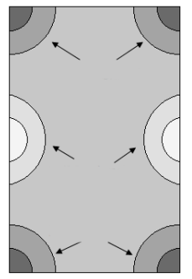
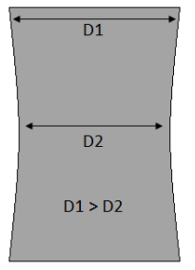
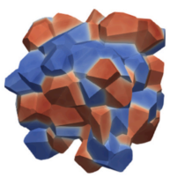
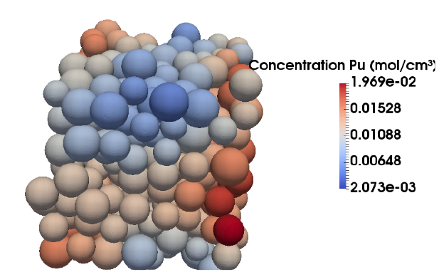
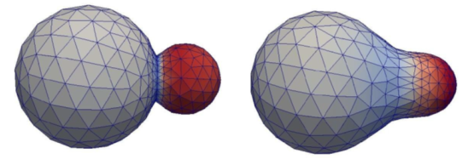
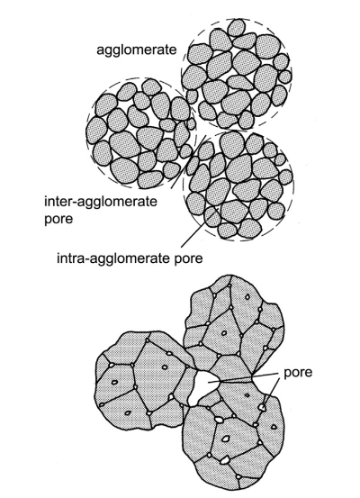
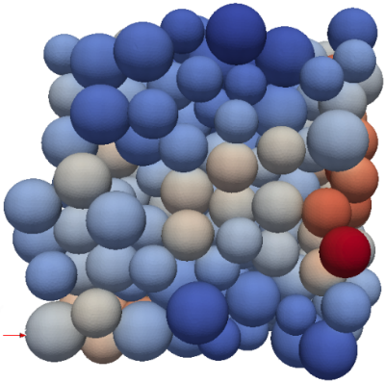
CEA simulation and multiscale approach to sintering
Microscopic
Mesoscopic
Macroscopic
Furnace…
VER
VER
Crystallites/grains
RVE
Pellet
Modelling grain growth
Material diffusion
Homogenization
Microstructural changes
Defect formation during sintering
Impact of heterogeneities
Oxygen transport
Thesis A. Ouhammou (2025)
Thesis N. Dempowo (2022)
Numerical
Thesis S. Martin (2014)
Model feeding
High density
Low density
High density
Salammbo
6
E. Pereira - Simulation of grain morphology evolution during sintering
Notes:
a traduire

Slide 7
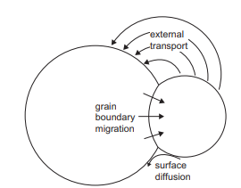
CEA simulation and multiscale approach to sintering
Microscopic
Mesoscopic
Macroscopic
Furnace…
VER
VER
Crystallites/grains
RVE
Pellet
Modelling grain growth
Material diffusion
Homogenization
Microstructural changes
Defect formation during sintering
Impact of heterogeneities
Oxygen transport
Thesis A. Ouhammou (2025)
Thesis N. Dempowo (2022)
Thesis S. Martin (2014)
2 grains
Model feeding
Numerical
High density
Low density
High density
Salammbo
Ph.D. topic : simulation from 2 crystallites to RVE
Multi-grain
7
E. Pereira - Simulation of grain morphology evolution during sintering
RVE
Notes:
a traduire

Slide 8
CEA simulation and multiscale approach to sintering
Microscopic
Mesoscopic
Macroscopic
Furnace…
VER
VER
Crystallites/grains
RVE
Pellet
Modelling grain growth
Material diffusion
Homogenization
Microstructural changes
Defect formation during sintering
Impact of heterogeneities
Oxygen transport
Ph.D. A. Ouhammou (2025)
Ph.D. N. Dempowo (2022)
Numerical
Ph.D. S. Martin (2014)
Model feeding
High density
Low density
High density
Salammbo
Ph.D. topic : simulation from 2 crystallites to RVE
Presentation topic :
working on two interface evolution methods:
phase field and adaptive meshes
8
E. Pereira - Simulation of grain morphology evolution during sintering
Notes:
a traduire

Slide 9
Models
2

Slide 10
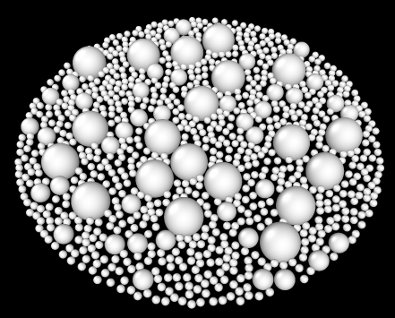
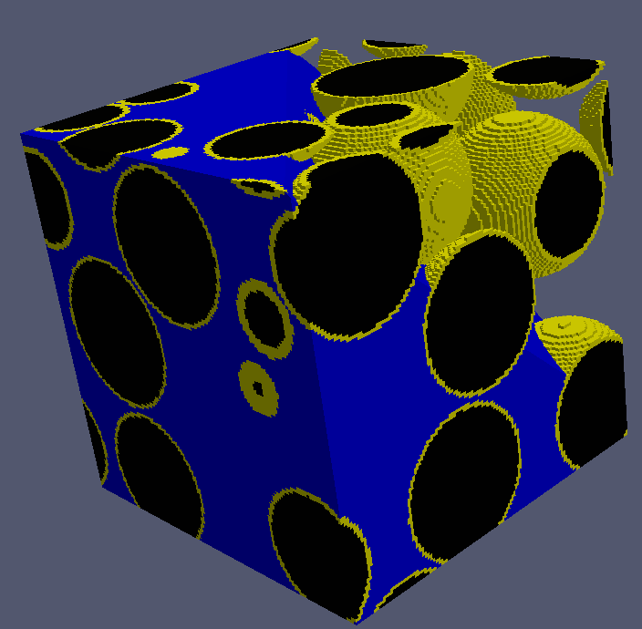
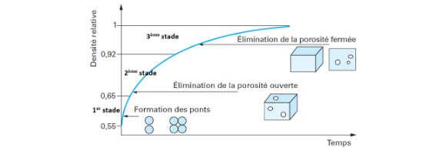
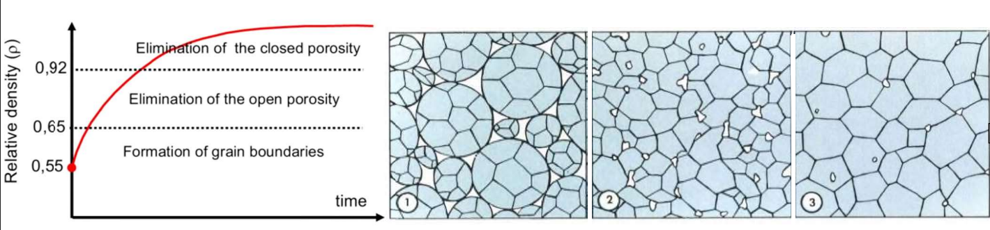
Hypothesis
Initial time :
  Temperature : 800–900 degrees
  Chromium : already solubilized in some grains
  Reduction to UO₂ at low temperature completed
  Generation of an initial microstructure using a set of spheres
Overall evolution in the RVE :
  O/M and temperature evolve uniformly across the domain
  Effect of the dopant, modification of some/every diffusion coefficients
Considerations about the study domain (RVE) :
  Aimed to solve several thousand of Degrees of Freedom
  Evolving boundary conditions due to shrinkage
Merope: A microstructure generator for simulation of heterogeneous materials, M. Josien, 2024
L
L’
E. Pereira - Simulation of grain morphology evolution during sintering
Notes:
Citer merope

Slide 11
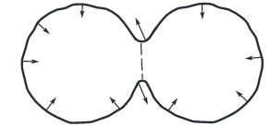

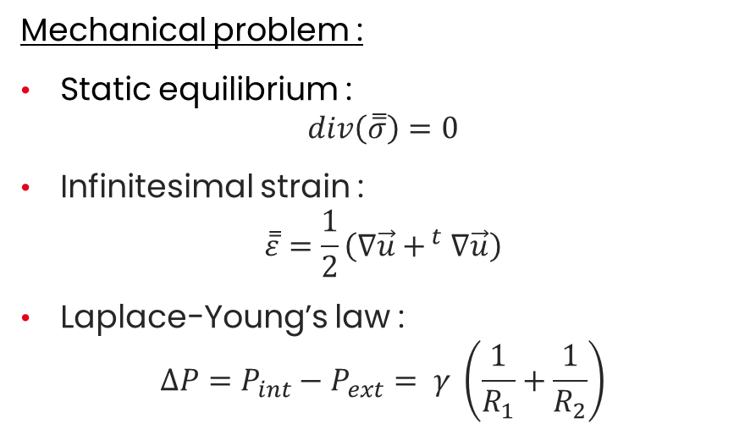



Multi-physics problem
Mechanical problem :
Static equilibrium :
$$div\left(\overset{̿}{σ}\right)=0$$
Infinitesimal strain :
$$\overset{̿}{ε}=\frac{1}{2}\left(∇\vec{u}+^{ t}∇\vec{u}\right)$$
Laplace-Young’s law :
$$ΔP=P_{int}−P_{ext}= γ \left(\frac{1}{R_{1}}+\frac{1}{R_{2}}\right)$$
Tension
$$∆P<0$$
$$∆P=0$$
Compression
$$∆P>0$$
Compression
$$∆P>0$$
11
E. Pereira - Simulation of grain morphology evolution during sintering

Slide 12
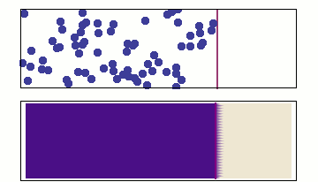
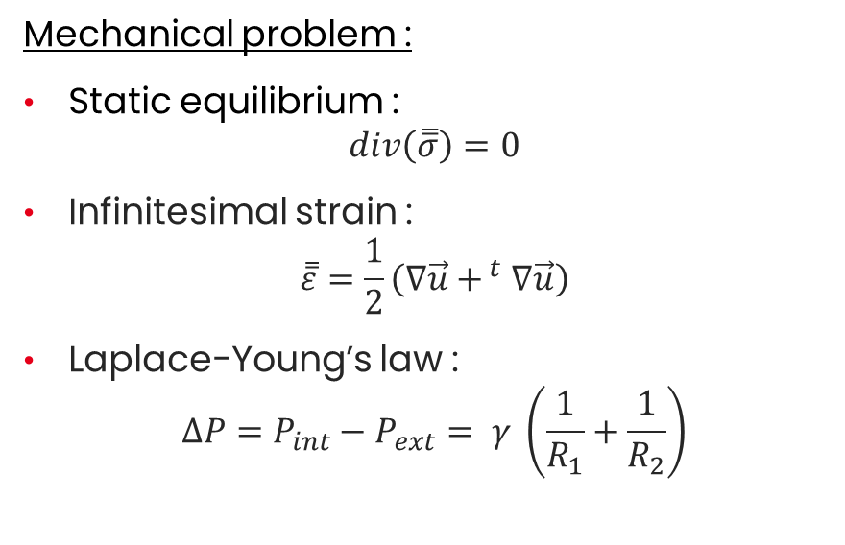
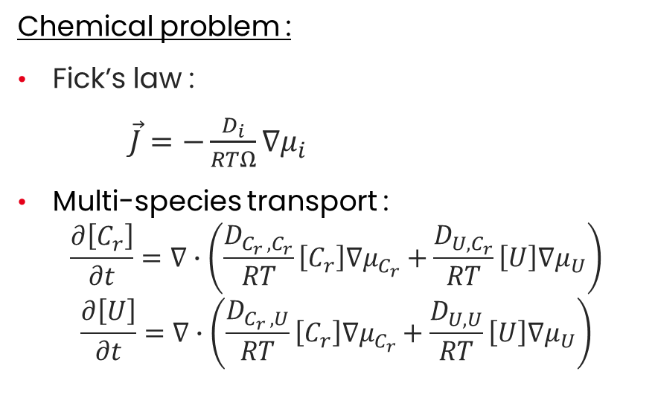
Multi-physics problem
Mechanical problem :
Static equilibrium :
$$div\left(\overset{̿}{σ}\right)=0$$
Infinitesimal strain :
$$\overset{̿}{ε}=\frac{1}{2}\left(∇\vec{u}+^{ t}∇\vec{u}\right)$$
Laplace-Young’s law :
$$ΔP=P_{int}−P_{ext}= γ \left(\frac{1}{R_{1}}+\frac{1}{R_{2}}\right)$$
Chemical problem :
Fick’s law :
$\vec{J}=−\frac{D_{i}}{RTΩ}∇μ_{i}$
Multi-species transport :
$$\frac{∂\left[C_{r}\right]}{∂t}=∇∙\left(\frac{D_{C_{r },C_{r}}}{RT}\left[C_{r}\right]∇μ_{C_{r}}+\frac{D_{U,C_{r}}}{RT}\left[U\right]∇μ_{U}\right)$$
$$\frac{∂\left[U\right]}{∂t}=∇∙\left(\frac{D_{C_{r },U}}{RT}\left[C_{r}\right]∇μ_{C_{r}}+\frac{D_{U,U}}{RT}\left[U\right]∇μ_{U}\right)$$
Tension
$$∆P<0$$
$$∆P=0$$
Compression
$$∆P>0$$
Compression
$$∆P>0$$
12
E. Pereira - Simulation of grain morphology evolution during sintering

Slide 13


Multi-physics problem
Mechanical problem :
Static equilibrium :
$$div\left(\overset{̿}{σ}\right)=0$$
Infinitesimal strain :
$$\overset{̿}{ε}=\frac{1}{2}\left(∇\vec{u}+^{ t}∇\vec{u}\right)$$
Laplace-Young’s law :
$$ΔP=P_{int}−P_{ext}= γ \left(\frac{1}{R_{1}}+\frac{1}{R_{2}}\right)$$
Chemical problem :
Fick’s law :
$\vec{J}=−\frac{D_{i}}{RTΩ}∇μ_{i}$
Multi-species transport :
$$\frac{∂\left[C_{r}\right]}{∂t}=∇∙\left(\frac{D_{C_{r },C_{r}}}{RT}\left[C_{r}\right]∇μ_{C_{r}}+\frac{D_{U,C_{r}}}{RT}\left[U\right]∇μ_{U}\right)$$
$$\frac{∂\left[U\right]}{∂t}=∇∙\left(\frac{D_{C_{r },U}}{RT}\left[C_{r}\right]∇μ_{C_{r}}+\frac{D_{U,U}}{RT}\left[U\right]∇μ_{U}\right)$$
Tension
$$∆P<0$$
Multiphysics coupling:
$$μi={\left(\frac{∂G}{∂n_{i}}\right)}_{T,P,i≠j }$$
$=μ_{i,0}\left(T\right)+μ_{i,C}(T)+ΩΔP$
$=μ_{i}^{0}+RT\ln\left(\frac{C_{i}}{C_{i,0}}\right)−Ω\frac{\operatorname{tr}\left(\overset{̿}{σ}\right)}{3}−$ $Ω\frac{\overset{̿}{σ}:\overset{̿}{ε}}{2}$
$$∆P=0$$
Compression
$$∆P>0$$
Compression
$$∆P>0$$
13
E. Pereira - Simulation of grain morphology evolution during sintering
Notes:
RAJOUTER IMAGE ANGLE DIEDRE

Slide 14
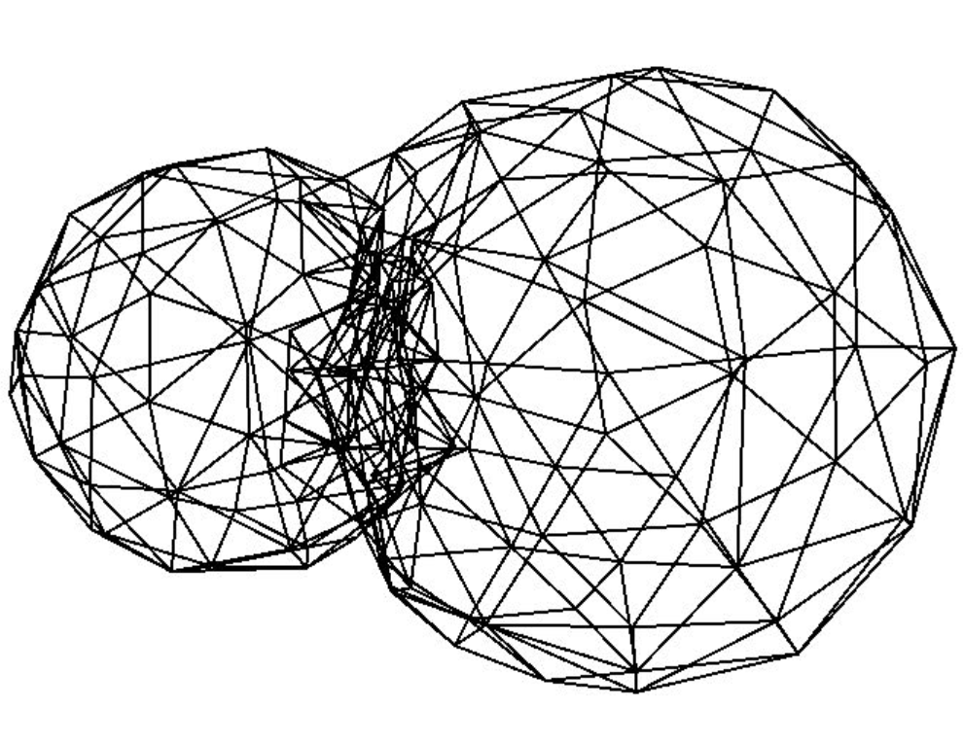

Interface evolution
FE Adaptive meshes [1]
Based directly on constitutive laws
Lagrangian, dynamic evolution of the mesh of the surface of the grains
Continuity of the flux :
$$J_{m,k}=−\frac{D_{m}}{3RT}\sum_{i=1}^{3}{\frac{{∂σ}_{i}}{{∂x}_{k}}}−\frac{D_{m}}{2RT}\sum_{i=1}^{6}{\sum_{j=1}^{6}{{c^{−1}}_{ij}(σ_{i}\frac{{∂σ}_{j}}{{∂x}_{k}}+}}σ_{j}\frac{{∂σ}_{i}}{{∂x}_{k}})$$
$$\vec{φ}=Ω\iint_{S}{{\vec{J}}_{v}∙\vec{n}+{div}_{s}\left({\vec{J}}_{int}+δ{\vec{T}}_{{\vec{J}}_{v}}\right)dS}$$
$${\vec{φ}}_{S}≈Ω(A_{S}{\vec{J}}_{v}∙\vec{n}+\sum_{a=1}^{3}{l_{a}\left({\vec{J}}_{int}+δ{\vec{T}}_{{\vec{J}}_{v}}\right)∙{\vec{n}}_{a}})$$
[1] J. Léchelle and al. «A sub-granular scale model for solid state free sintering: results on the evolution of two grains», Journal of chemical technology and metallurgy, 2014
14
E. Pereira - Simulation of grain morphology evolution during sintering
Notes:
Lier avec slide 13
Intégrale en grand

Slide 15
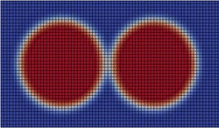
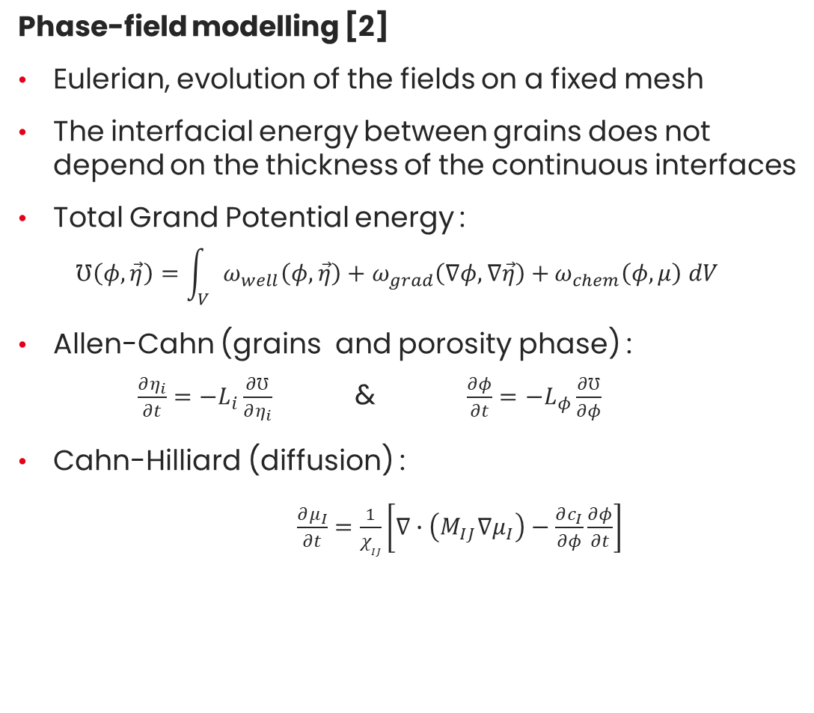
Interface evolution
FE Adaptive meshes [1]
Based directly on constitutive laws
Lagrangian, dynamic evolution of the mesh of the surface of the grains
Continuity of the flux :
Phase-field modelling [2]
Eulerian, evolution of the fields on a fixed mesh
The interfacial energy between grains does not depend on the thickness of the continuous interfaces
Total Grand Potential energy :
$℧\left(φ,\vec{η}\right)=\int_{V}{ω_{well}\left(φ,\vec{η}\right)+ω_{grad}\left(∇φ,∇\vec{η}\right)+}ω_{chem}\left(φ,μ\right) dV$
Allen-Cahn (grains and porosity phase) :
$\frac{∂η_{i}}{∂t}=−L_{i}\frac{∂℧}{∂η_{i}}$ & $\frac{∂φ}{∂t}=−L_{φ}\frac{∂℧}{∂φ}$
Cahn-Hilliard (diffusion) :
$\frac{∂μ_{I}}{∂t}=\frac{1}{χ_{IJ}}\left[∇∙\left(M_{IJ}∇μ_{I}\right)−\frac{∂c_{I}}{∂φ}\frac{∂φ}{∂t}\right]$
$$J_{m,k}=−\frac{D_{m}}{3RT}\sum_{i=1}^{3}{\frac{{∂σ}_{i}}{{∂x}_{k}}}−\frac{D_{m}}{2RT}\sum_{i=1}^{6}{\sum_{j=1}^{6}{{c^{−1}}_{ij}(σ_{i}\frac{{∂σ}_{j}}{{∂x}_{k}}+}}σ_{j}\frac{{∂σ}_{i}}{{∂x}_{k}})$$
$$\vec{φ}=Ω\iint_{S}{{\vec{J}}_{v}∙\vec{n}+{div}_{s}\left({\vec{J}}_{int}+δ{\vec{T}}_{{\vec{J}}_{v}}\right)dS}$$
$${\vec{φ}}_{S}≈Ω(A_{S}{\vec{J}}_{v}∙\vec{n}+\sum_{a=1}^{3}{l_{a}\left({\vec{J}}_{int}+δ{\vec{T}}_{{\vec{J}}_{v}}\right)∙{\vec{n}}_{a}})$$
[1] J. Léchelle and al. «A sub-granular scale model for solid state free sintering: results on the evolution of two grains», Journal of chemical technology and metallurgy, 2014
[2] I. Greenquist and al. «Development of a microstructural grand potential-based sintering model», Computational Materials Science, 2020
15
E. Pereira - Simulation of grain morphology evolution during sintering
Notes:
Lier avec slide 13
Intégrale en grand

Slide 16


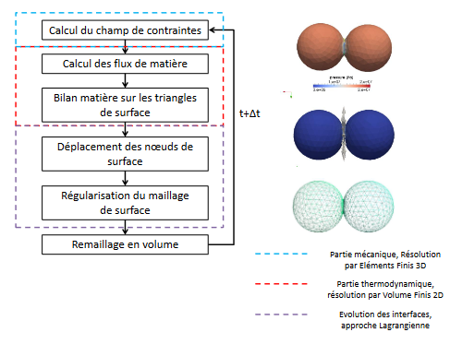
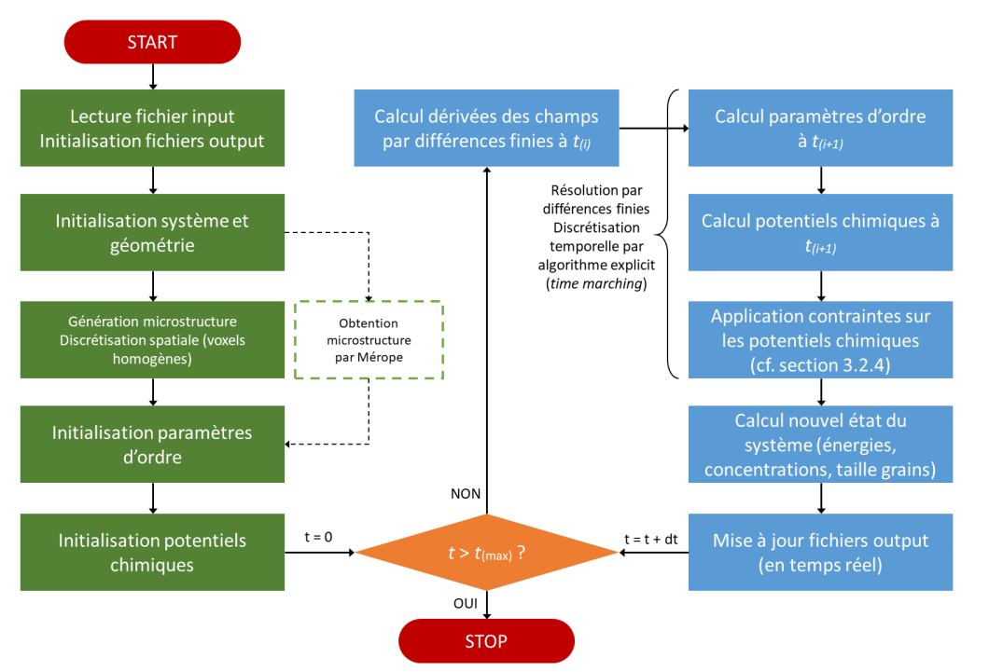

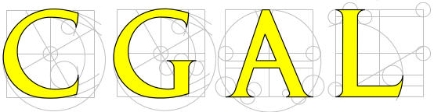
CEA Software algorithm
SALAMMBO : FE Adaptive meshes [1]
Mechanical section
3D Finite Element solving
Stress field calculation
Material flows calculation
Thermodynamic section
2D Finite Volume solving
Material balance on surface triangles
Interfaces evolution
Lagrangian approch
Displacement of surface nodes
Smoothing of the surface mesh
Remeshing of the volume
[1] J. Léchelle and al. «A sub-granular scale model for solid state free sintering: results on the evolution of two grains», Journal of chemical technology and metallurgy, 2014
16
E. Pereira - Simulation of grain morphology evolution during sintering
Notes:
Traduire salammbo

Slide 17


CEA Software algorithm
SALAMMBO : FE Adaptive meshes [1]
INFERNO : Phase-field modelling [3]
Mechanical section
3D Finite Element solving
Mechanical section
3D Finite Element solving
Stress field calculation
Stress field calculation
Calculation of the order parameters at $t_{i+1}$
Calculation of the order parameters at 𝑡_(𝑖+1)
Calculation of the chemical potential at $t_{i+1}$
Calculation of the chemical potential at 𝑡_(𝑖+1)
Constraints on the chemical potential
Computation of the new system state
Calculations of fields derivatives at $t_{i}$
Calculations of fields derivatives at 𝑡_𝑖
Material flows calculation
Material flows calculation
Thermodynamic section
2D Finite Volume solving
Thermodynamic section
2D Finite Volume solving
Material balance on surface triangles
Material balance on surface triangles
Displacement of surface nodes
Interfaces evolution
Lagrangian approch
Displacement of surface nodes
Interfaces evolution
Lagrangian approch
Smoothing of the surface mesh
Smoothing of the surface mesh
Remeshing of the volume
Remeshing of the volume
[1] J. Léchelle and al. «A sub-granular scale model for solid state free sintering: results on the evolution of two grains», Journal of chemical technology and metallurgy, 2014
[3] L. Messina, “Phase-field modeling and benchmark of microstructure evolution in polycrystalline UO2 with the INFERNO code”, presented at the NuFuel conference, Delft, the Netherlands, Sept 18, 2025.
17
E. Pereira - Simulation of grain morphology evolution during sintering
Notes:
NOM DES METHODES : adaptive meshes et phase field

Slide 18
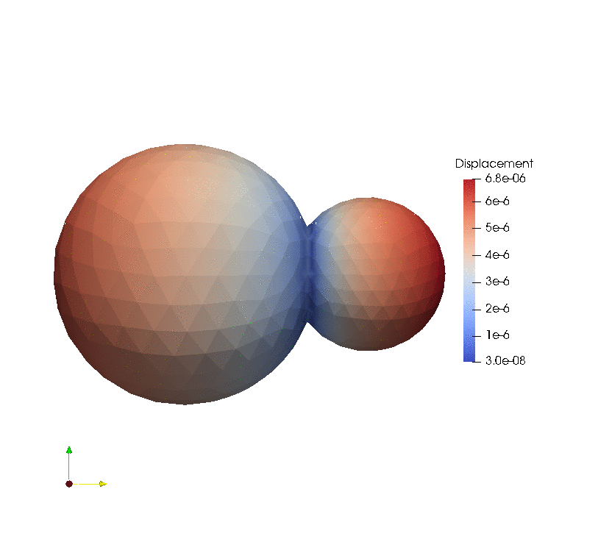
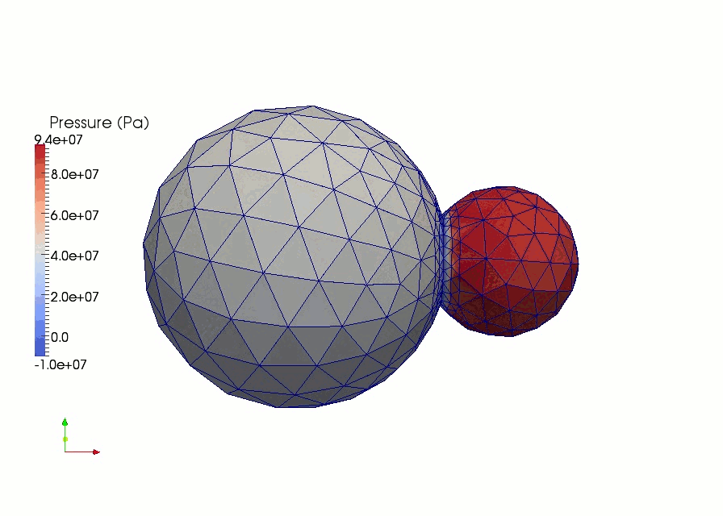
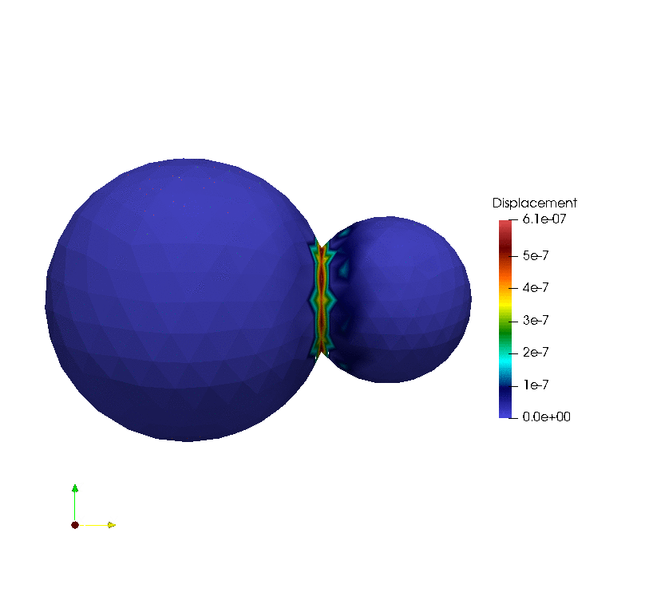
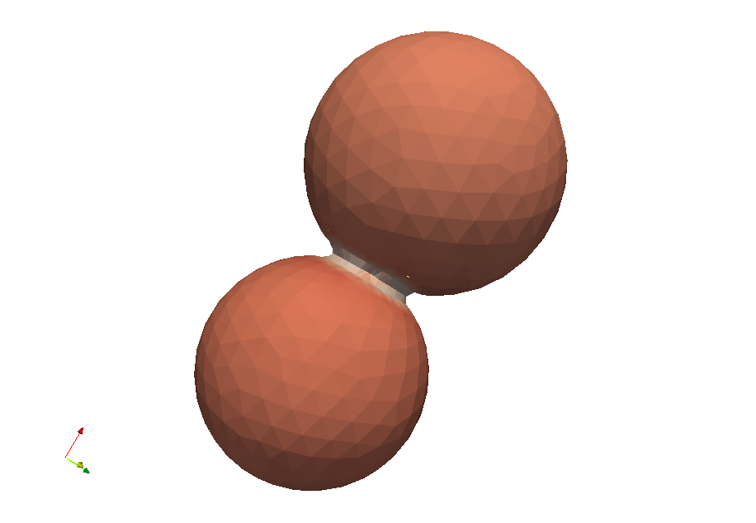
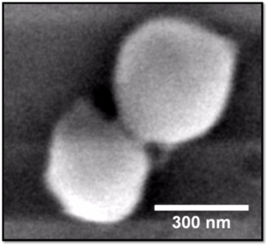
Results : Salammbo
Validation on CeO₂
  [1]
[1] Ph.D. S. Martin, 2014, « Contribution to the modelling of solid state sintering »
[2] Ph.D. G. I. Nkou Bouala, 2016, «First step of sintering of lanthanides and actinides oxides : an in situ study by ESEM at high temperature»
  [1]
  [2]
18
E. Pereira - Simulation of grain morphology evolution during sintering
Notes:
Matériau homogène

Slide 19
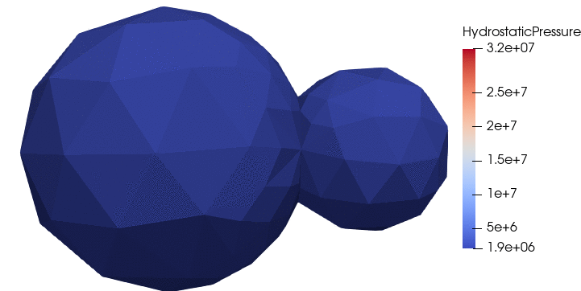
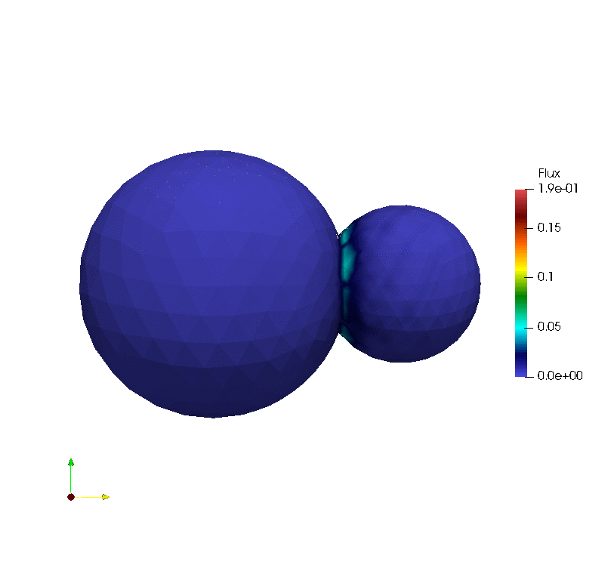

Results : Salammbo
Validation on CeO₂
Extension to chromia doped
  [1]
Average dihedral angle at 70°
Increase of the neck
Chemical homogenization
[1] Ph.D. S. Martin, 2014, « Contribution to the modelling of solid state sintering »
[2] Ph.D. G. I. Nkou Bouala, 2016, «First step of sintering of lanthanides and actinides oxides : an in situ study by ESEM at high temperature»
  [1]
  [2]
19
E. Pereira - Simulation of grain morphology evolution during sintering
Notes:
AS : Rajouter références

Slide 20
Results : Salammbo
Validation on CeO₂
Extension to chromia doped
  [1]
Average dihedral angle at 70°
Increase of the neck
Chemical homogenization
[1] Ph.D. S. Martin, 2014, « Contribution to the modelling of solid state sintering »
[2] Ph.D. G. I. Nkou Bouala, 2016, «First step of sintering of lanthanides and actinides oxides : an in situ study by ESEM at high temperature»
  [1]
  [2]
Issue with multiple grains phase field approach
20
E. Pereira - Simulation of grain morphology evolution during sintering
Notes:
AS : Rajouter références

Slide 21


Verification : Inferno
Implement Greenquist model, developed also for UO₂ and doped (chromium)
Compare the first results
I. Greenquist and al. «Development of a microstructural grand potential-based sintering model», Computational Materials Science, 2020
21
E. Pereira - Simulation of grain morphology evolution during sintering
Notes:
Rajouter Références

Slide 22

Verification : Inferno
Implement Greenquist model, developed also for UO₂ and doped (chromium)
Compare the first results
The concentration in grain must be heterogenous according to [Greenquist et al., 2020]
Must improve the concentration equilibrium computation
22
E. Pereira - Simulation of grain morphology evolution during sintering

Slide 23


Verification : Inferno
Implement Greenquist model, developed also for UO₂ and doped (chromium)
Compare the first results
Issue with the equilibrium concentrations
Extend Greenquist method to Uranium diffusion instead of vacancy in order to coupled phase -field with mechanical solver
The concentration in grain must be heterogenous according to [Greenquist et al., 2020]
Must improve the concentration equilibrium computation
23
E. Pereira - Simulation of grain morphology evolution during sintering

Slide 24
Conclusion & Outlook
3

Slide 25
Conclusion
Development of multi-species sintering model at RVE scale to study the chromia doped fuel
Work on Salammbo (adaptive meshes):
  Extend model for multi-species sintering
  Further works will be focused on phase-field model due to CPU time and multi-grain issues
First implementation of Greenquist model and verification
25
E. Pereira - Simulation of grain morphology evolution during sintering

Slide 26
Conclusion
Development of multi-species sintering model at RVE scale to study the chromia doped fuel
Work on Salammbo (adaptive meshes):
  Extend model for multi-species sintering
  Further works will be focused on phase-field model due to CPU time and multi-grain issues
First implementation of Greenquist model and verification
  Extend Greenquist method to Uranium diffusion instead of vacancy
  Benchmark between Salammbo and Inferno
  Coupled phase field method with mechanical solver, compared with multi-grains systems
  Extension to Uranium and doped sintering for phase-field model
Outlook
26
E. Pereira - Simulation of grain morphology evolution during sintering

Slide 27
Thanks for your attention
Evan Pereira
Evan.PEREIRA@cea.fr

Slide 28





Context : Sintering of the fuel pellet
Micro-scale behavior :
Mass transport, primarily driven by solid-state diffusion at grains boundaries and surface
⬈ grain size (from 1 to 10 μm up to 5 and 25 μm)
⬊ porosity and number of grains
Macro-scale behavior :
Target O/M stoichiometry close to 2
⬊ volume due to shrinkage (may require adjustment)
⬈ density from ~55% to ~95%
50 μm
High density
Low density
High density
Residual closed pores are important to trap fission gases within the microstructure.
Notes:
A relative density of 100% is not the goal, as the residual closed pores serve to trap fission gases within the microstructure.

Slide 29



Software
SALAMMBO :
Interfaces displacement
INFERNO :
Order parameter
Material based reformulation
MASQUEE
A VOIR SI JE GARDE
$$\overset{→}{D_{2}}$$
$$S_{2}$$
$$\overset{→}{D_{3}}$$
$$\overset{→}{J}$$
$$\overset{→}{D_{1}}$$
$$S_{1}$$
$$S_{3}$$

